Slide 1
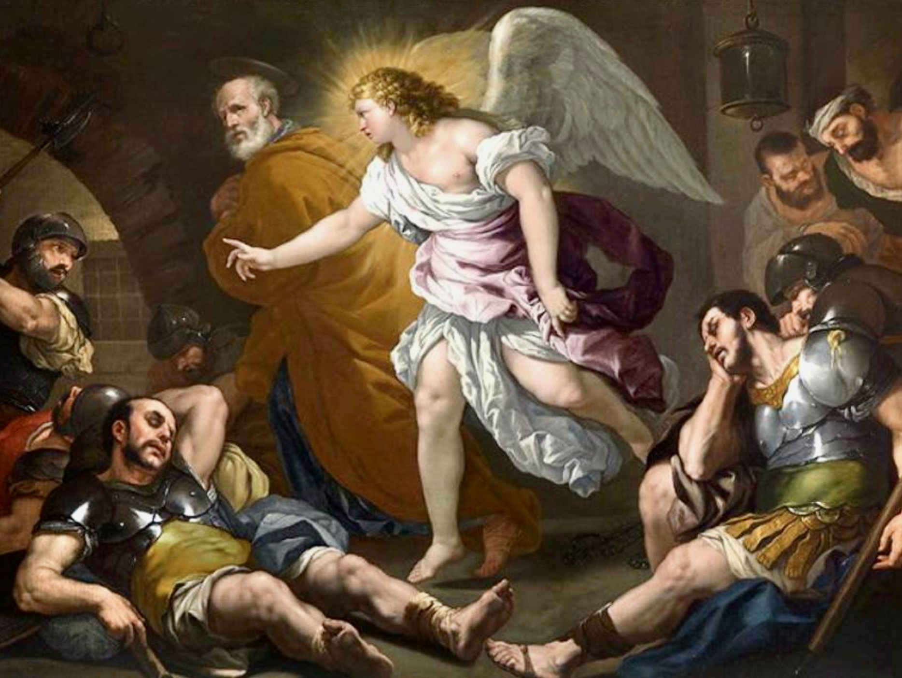
天使行動的啟發
Inspiration from angel action
房正豪牧師
Pastor Fang

Slide 2
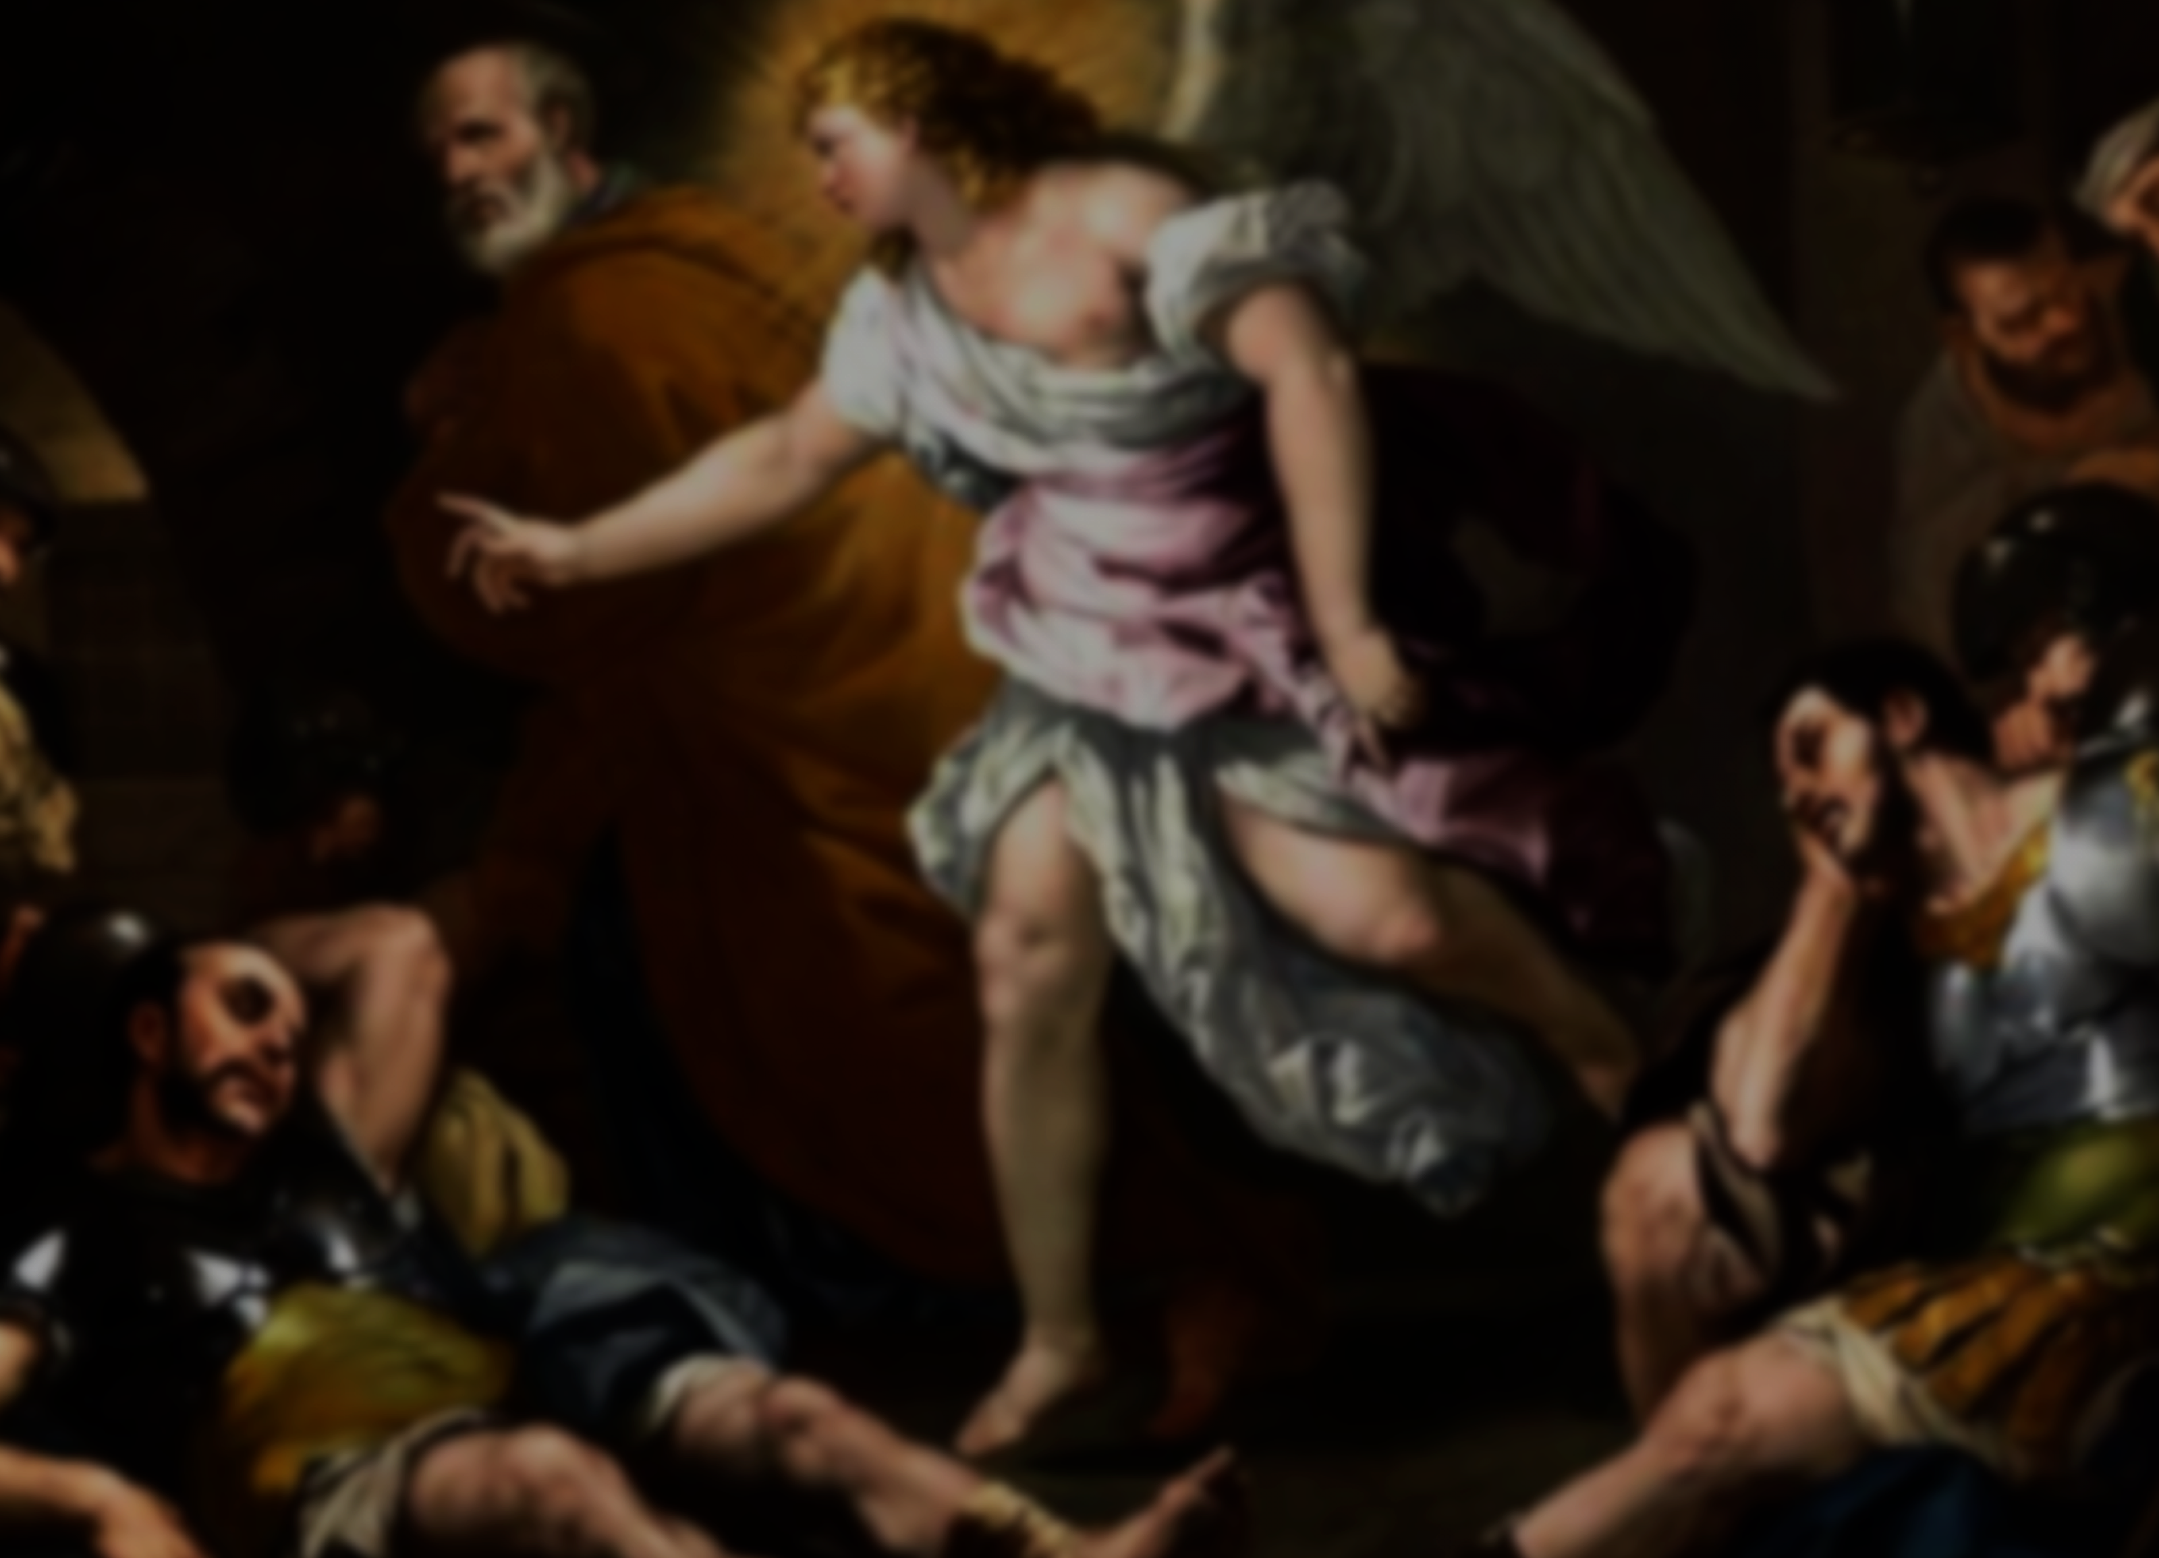
使徒行传 12: 6
6 希律将要提他出来的前一夜，彼得被两条铁链锁着，睡在两个兵丁当中，看守的人也在门外看守。

Slide 3
Acts 12: 6
6 The night before Herod was to bring him to trial, Peter was sleeping between two soldiers, bound with two chains, and sentries stood guard at the entrance.

Slide 4
使徒行传 12: 7-8
7 忽然，有主的一个使者站在旁边，屋里有光照耀。天使拍彼得的肋旁，拍醒了他，说：“快快起来！”那铁链就从他手上脱落下来。

Slide 5
使徒行传 12: 7-8
8 天使对他说：“束上带子，穿上鞋！”他就那样做。天使又说：“披上外衣，跟着我来！”

Slide 6
Acts 12: 7-8
7 Suddenly an angel of the Lord appeared and a light shone in the cell. He struck Peter on the side and woke him up. “Quick, get up!” he said, and the chains fell off Peter’s wrists.

Slide 7
Acts 12: 7-8
8 Then the angel said to him, “Put on your clothes and sandals.” And Peter did so. “Wrap your cloak around you and follow me,” the angel told him.

Slide 8
使徒行传 12: 9-11
9 彼得就出来跟着他，不知道天使所做是真的，只当见了异象。 10 过了第一层、第二层监牢，就来到临街的铁门，那门自己开了。他们出来，走过一条街，天使便离开他去了。

Slide 9
使徒行传 12: 9-11
11 彼得醒悟过来，说：“我现在真知道主差遣他的使者，救我脱离希律的手和犹太百姓一切所盼望的。”

Slide 10
Acts 12: 9-11
9 Peter followed him out of the prison, but he had no idea that what the angel was doing was really happening; he thought he was seeing a vision

Slide 11
Acts 12: 9-11
10 They passed the first and second guards and came to the iron gate leading to the city. It opened for them by itself, and they went through it. When they had walked the length of one street, suddenly the angel left him.

Slide 12
Acts 12: 9-11
11 Then Peter came to himself and said, “Now I know without a doubt that the Lord has sent his angel and rescued me from Herod’s clutches and from everything the Jewish people were hoping would happen.”

Slide 13
雅各書 James 1 1: 22
22 只是你们要行道，不要单单听道，自己欺哄自己。
22 Do not merely listen to the word, and so deceive yourselves. Do what it says.

Slide 14
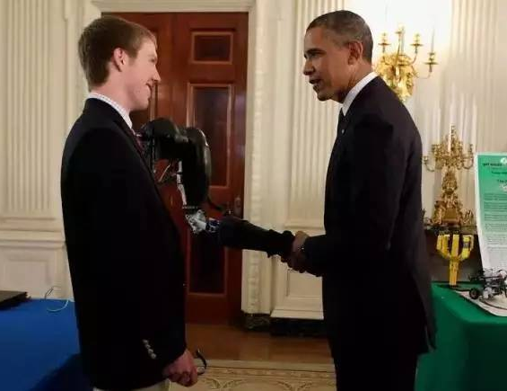
Easton La Chappelle 19岁

Slide 15
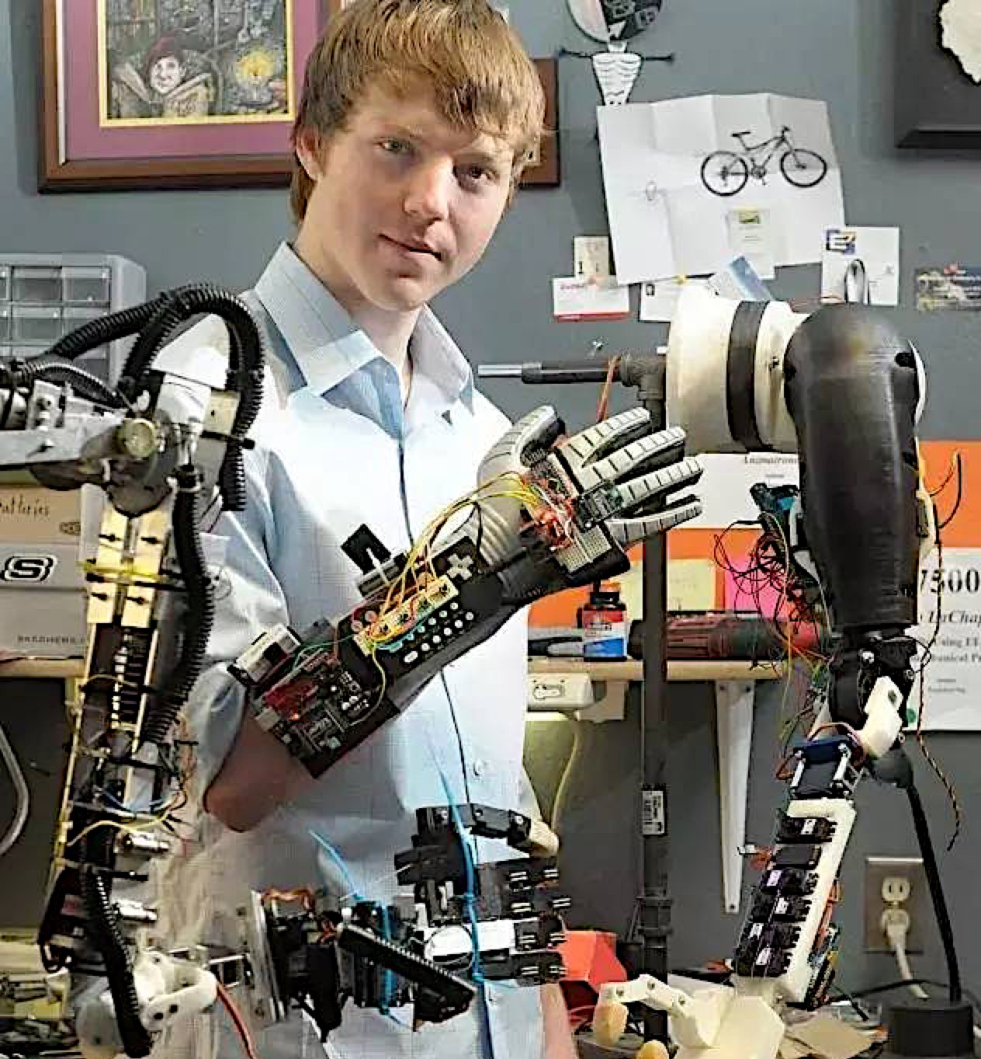

Slide 16
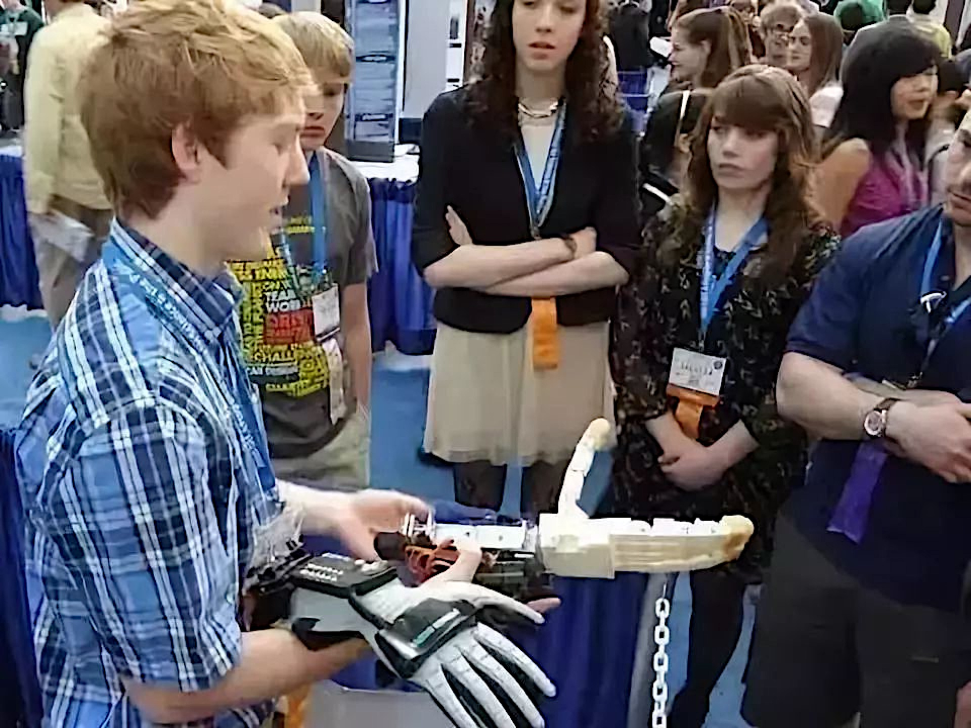

Slide 17
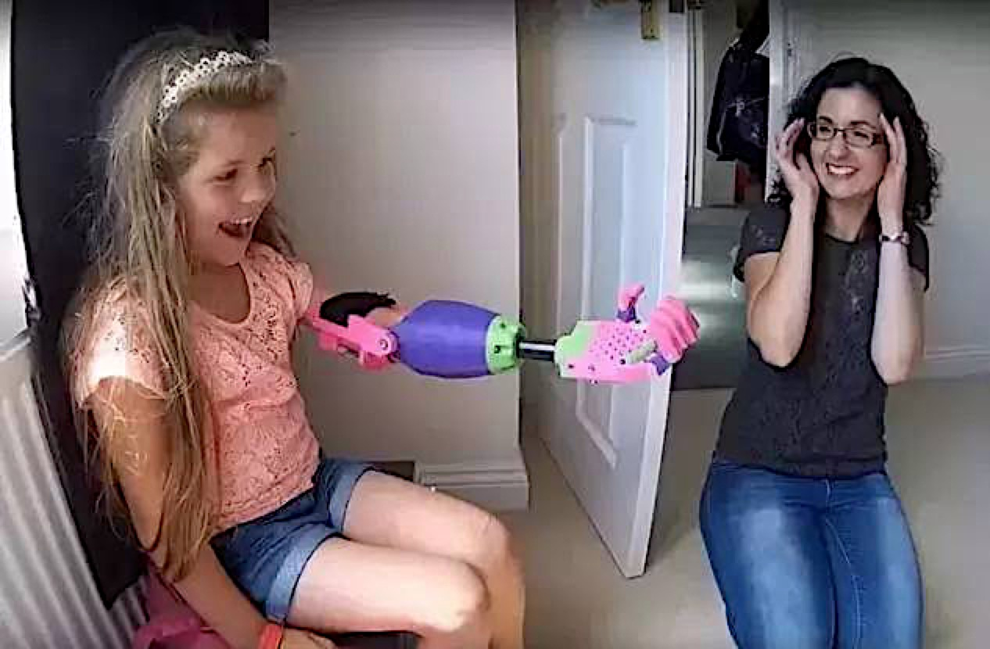

Slide 18
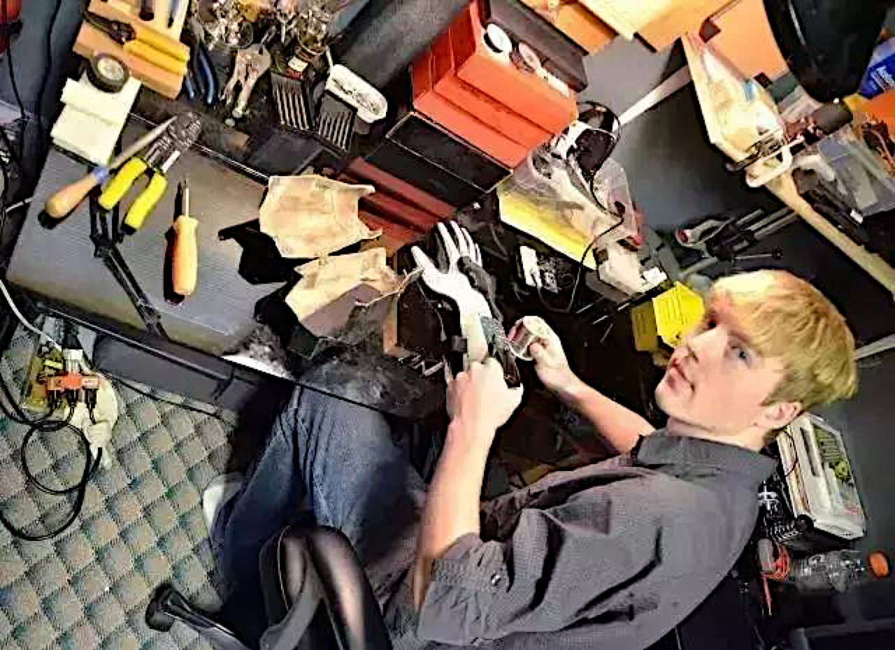

Slide 19
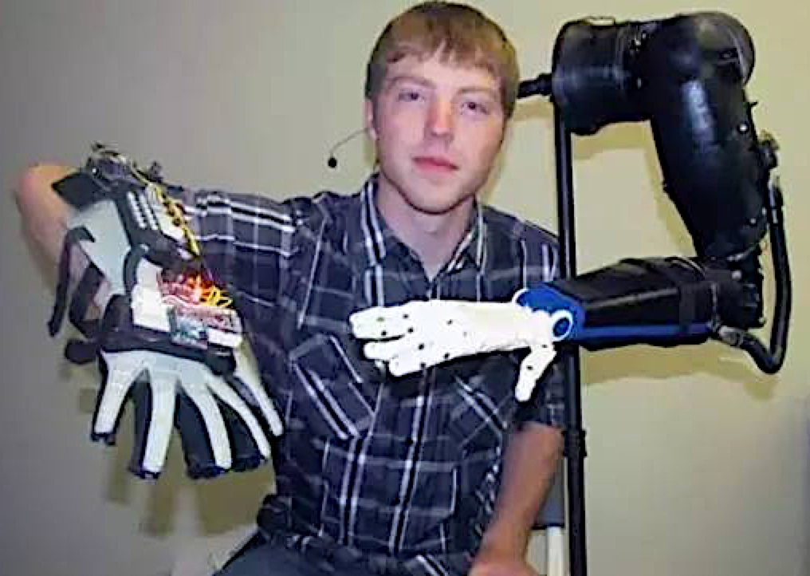

Slide 20
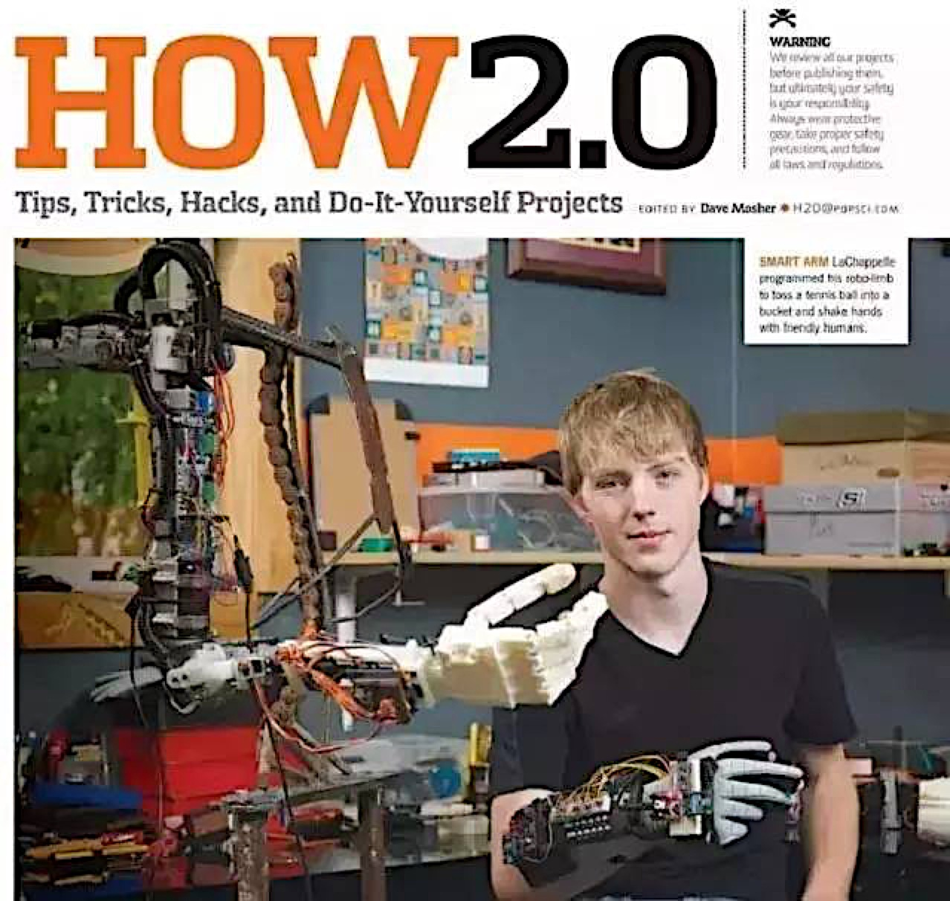

Slide 21
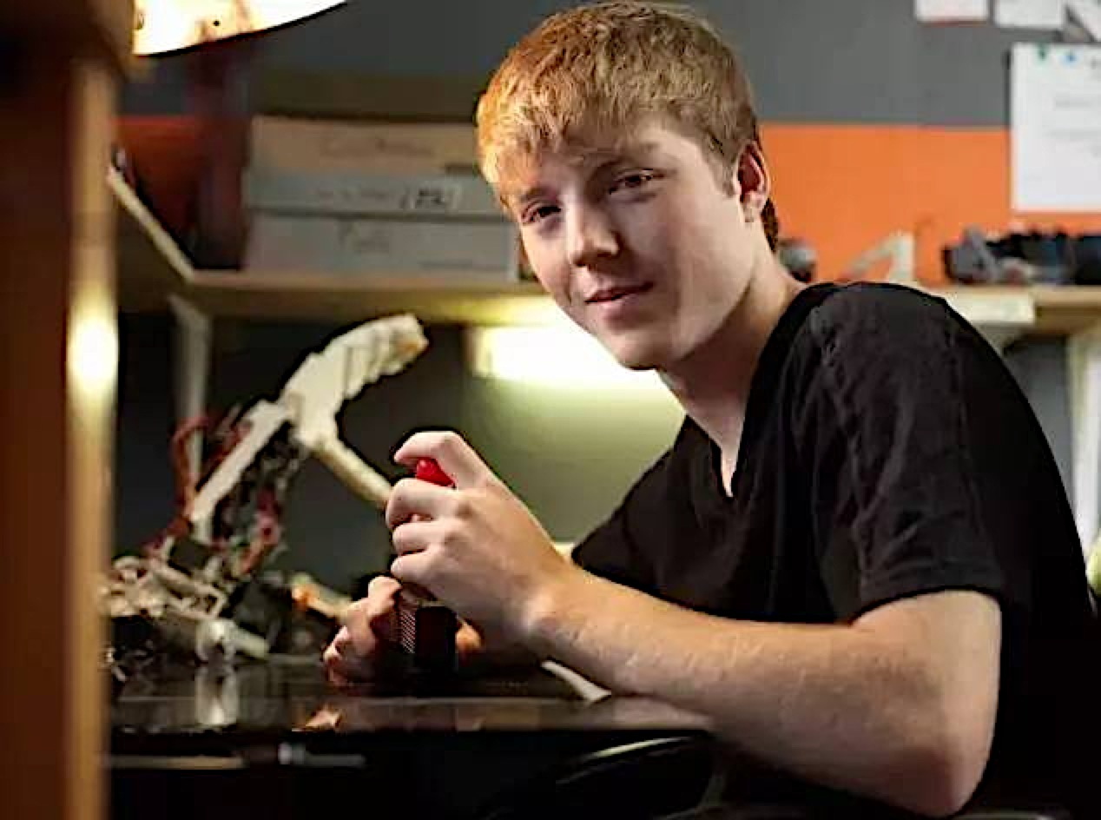

Slide 22
愛心的行動
Caring action

Slide 23
以弗所書 Ephesians 1 2: 10
10 我们原是他的工作，在基督耶稣里造成的，为要叫我们行善，就是神所预备叫我们行的。
10 For we are God’s handiwork, created in Christ Jesus to do good works, which God prepared in advance for us to do.

Slide 24
面對疫情的態度
Attitude towards the epidemic
1：谨慎而不是恐慌害怕。
Be cautious rather than panic.
2：代祷而不是批评论断。
Intercession rather than criticism.
3：分辨真假而不传播谣言。
Discern the truth without spreading rumors.
4：属灵的警醒而不沉睡，作好准备。
Spiritual alert and be ready

Slide 25
“靠主站穩”
是實際的真理
The truth is
“Standing Firm in the Lord.”

Slide 26
我們服事“同一位主”
We serve “the same Lord.”
我們傳揚“同樣的福音”
We preach “the same Gospel.”
我們高舉是“同一個十字架”
We lift“ the same Cross.”

Slide 27
提摩太前书 1 Timothy 3:15b
这家就是永生神的教会，
真理的柱石和根基。
which is the church of the living God, the pillar and foundation of the truth.

Slide 28
回應信息的行動
Responding actions
1：每天好好的读经祷告
Bible reading and prayer every day
2：每个礼拜記好金句並默想
Meditation and scripture recitation every week

