Slide 1
如何教養敬虔的後代
How to educate your offspring?
房正豪牧師

Slide 2
提摩太后书 2 Timothy 1:5-7
5 我记得你心里无伪的信心，这信心原先是在你外祖母罗以和你母亲友尼基心里的，我深信也在你的心里。

Slide 3
提摩太后书 2 Timothy 1:5-7
6 为了这缘故，我提醒你，要把 神借着我按手给你的恩赐，像火一样再挑旺起来。
7 因为 神所赐给我们的，不是胆怯的灵，而是有能力、仁爱、自律的灵。

Slide 4
提摩太后书 2 Timothy 1:5-7
5 I am reminded of your sincere faith, which first lived in your grandmother Lois and in your mother Eunice and, I am persuaded, now lives in you also.

Slide 5
提摩太后书 2 Timothy 1:5-7
6 For this reason I remind you to fan into flame the gift of God, which is in you through the laying on of my hands.
7 For the Spirit God gave us does not make us timid, but gives us power, love and self-discipline.

Slide 6
父母以身作则，带领全家，尊主为大！
Parents must lead by example, leading the family to honor the Lord!

Slide 7
提摩太后书 2 Timothy 3:14-15
14 你应当遵守所学和确信的；你知道是跟谁学的，
15 并且知道自己从小就明白圣经，这圣经能够使你有智慧，可以因信基督耶稣得着救恩。

Slide 8
提摩太后书 2 Timothy 3:14-15
14 But as for you, continue in what you have learned and have become convinced of, because you know those from whom you learned it,
15 and how from infancy you have known the Holy Scriptures, which are able to make you wise for salvation through faith in Christ Jesus.

Slide 9
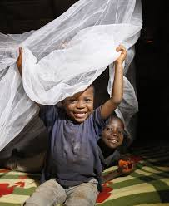
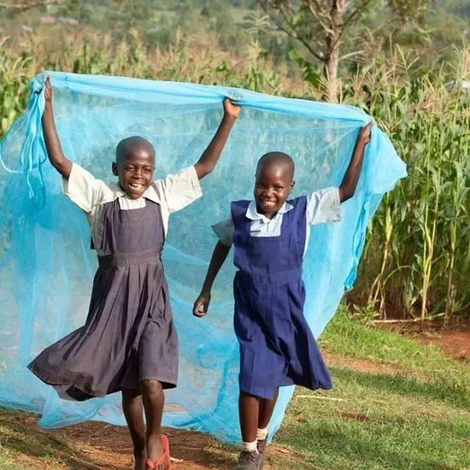
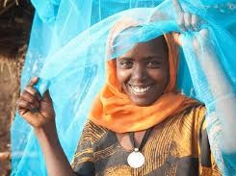

Slide 10
神的話可以增加我們的
愛心、信心、盼望。
God’s word will strength your love, faith and hope

Slide 11
耶穌哭了!
Jesus cried
約翰福音 11:35

Slide 12
床前明月光，疑是地上霜，
舉頭望明月，低頭思故鄉。
Before my bed there is bright moonlight that seems light frost on the ground. Lifting my head towards the moon, lowering my head I dream that I’m home

Slide 13
天上的白雲好像棉花糖，
我抬頭看天上的白雲，
低頭想著起去年外婆帶我吃的刨冰。As I look up to the sky the clouds resemble cotton candy. As I look down I recalled the time when Grandma treated me to shaved-ice!

Slide 14
滿有創新的能力!
Filled with the power of creativity

Slide 15
培養孩子「獨立思考的能力」！Develop the child’s power of “independent thinking”!

Slide 16
你希望你家裡充滿孩子的笑聲？Do you wish your home be filled with children’s laughter?

Slide 17
你願意對你孩子說故事嗎？
Do you wish to tell your child stories?
而不是一直對他「說教」！
Or rather be “preachy” to them!

Slide 18
如何教養敬虔的後代
How to educate your offspring?

Slide 19
1.父母以身作则，带领全家，尊主为大！
Parents must lead by example, leading the family to honor the Lord!
2.父母要给孩子成长的空间，理解中
美文化的不同！
Parents must allow their child the space to grow up, and understand the difference between Chinese & American culture?
3.父母要接纳孩子兴趣，接纳孩子的朋友！
Parents must accept their child’s interest, and also his friends!

Slide 20
4.父母要引导孩子独立思考的能力，
勇于创新突破！
Parents must develop power of independent thinking in their child, so that he may have creative breakthrough!
5.父母要支持自己的孩子，永远爱孩子到
底！
Parents must be supportive of their child, and love him to the very end

