Slide 1

房正豪牧師

Slide 2
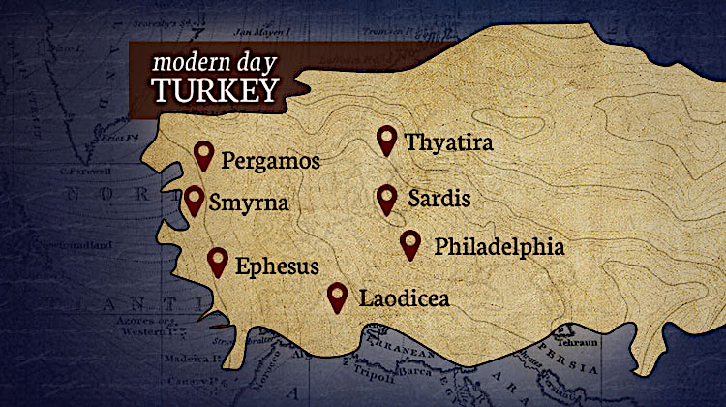
土 耳 其
別迦摩
推雅推喇
士每拿
撒狄
拉菲鐵非
以弗所
老底嘉

Slide 3
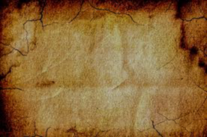
启示录 2:14
然而，有几件事我要责备你，因为在你那里，有人服从了巴兰的教训。这巴兰曾教导巴勒将绊脚石放在以色列人面前，叫他们吃祭偶像之物，行奸淫的事。

Slide 4
Revelation 2:14
Nevertheless, I have a few things against you: There are some among you who hold to the teaching of Balaam, who taught Balak to entice the Israelites to sin so that they ate food sacrificed to idols and committed sexual immorality.

Slide 5
民数记 25:1-3
1 以色列人住在什亭，百姓与摩押女子行起淫乱。 2 因为这女子叫百姓来，一同给她们的神献祭，百姓就吃她们的祭物，跪拜她们的神。 3 以色列人与巴力毗珥联合，耶和华的怒气就向以色列人发作。

Slide 6
Numbers 25:1-3
While Israel was staying in Shittim, the men began to indulge in sexual immorality with Moabite women, 2 who invited them to the sacrifices to their gods. The people ate the sacrificial meal and bowed down before these gods. 3 So Israel yoked themselves to the Baal of Peor. And the Lord’s anger burned against them.

Slide 7
提摩太前书 1 Timothy 6:10
贪财是万恶之根。有人贪恋钱财，就被引诱离了真道，用许多愁苦把自己刺透了。
For the love of money is a root of all kinds of evil. Some people, eager for money, have wandered from the faith and pierced themselves with many griefs.

Slide 8
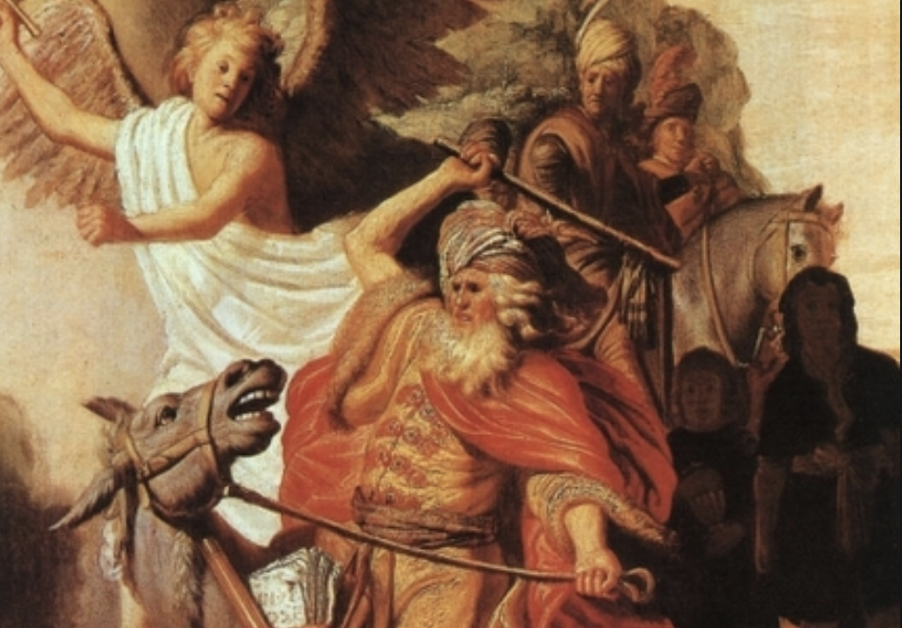
巴兰没有原则
他贪爱钱财
Balaam did not hold his principle.
He is greedy with money.

Slide 9
提摩太前书 1 Timothy 3:15(b)
这家就是永生神的教会，真理的柱石和根基。
Which is the church of the living God, the pillar and foundation of the truth.

Slide 10
教会是属主的就不能和世界妥协
The church belongs to the lord,
therefore can not compromise with the world.

Slide 11

小心撒旦！正利用媒體来迷惑众人
Be careful and be alert about Satan!
He is using the media to confuse people.

Slide 12
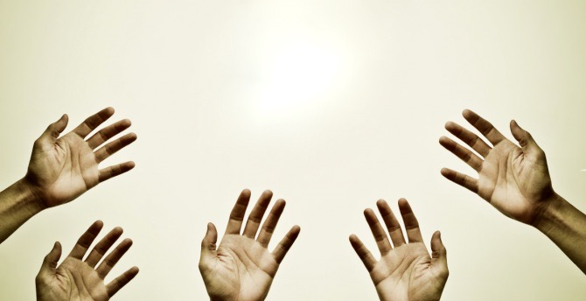
贪欲Greed
权力Power and authority
金钱Money
女色woman
名声 fame
地位social status

Slide 13
为什么人会妥协呢？
Why do people compromise?
1.受到很大的压力！
They are under tremendous presuure!
2.自己可以得到许多的利益！
They can get huge profit from it!

Slide 14
当选择过"圣洁敬虔"的生活
We should choose to live
in a holy and faithful life.

Slide 15
启示录 Revelation 2:15
你那里也有人照样服从了尼哥拉一党人的教训。
Likewise, you also have those who hold to the teaching of the Nicolaitans.

Slide 16
出埃及 Exodus 20:1-3
1 神吩咐这一切的话说： 2 “我是耶和华你的神，曾将你从埃及地为奴之家领出来。3 “除了我以外，你不可有别的神。
1 And God spoke all these words: 2 “I am the Lord your God, who brought you out of Egypt, out of the land of slavery. 3 “You shall have no other gods before me.

Slide 17
慎防隐藏的骄傲
Be careful with the hidden pride
and arrogance.

Slide 18
建立三心教会
The church of faith, care and joy.
忠心的教会：遵守主的教导。
Faithful church, obey lord's teaching.
2. 关心的教会：分享主的大爱。
Caring church, share lord's almighty love.
3. 开心的教会：靠主 常常喜乐。
Joyful church, always joyful in the lord.

Slide 19

沒有異像 NO VISION
沒有任務 NO MISSION
沒有熱情 NO PASSION

Slide 20

有異像 HAVE VISION
有任務 HAVE MISSION
有熱情 HAVE PASSION

Slide 21
我们的异象 Our vision.
1. 高举耶稣的十字架
Hold high of Jesus's Cross.
2. 信圣经是神的启示
Believe that the Bible is God's revelation.
3. 主耶稣基督会回来
Our lord Jesus Christ will come back!

