Slide 1
How to revitalize a church that exists in name only?
房正豪牧師

Slide 2
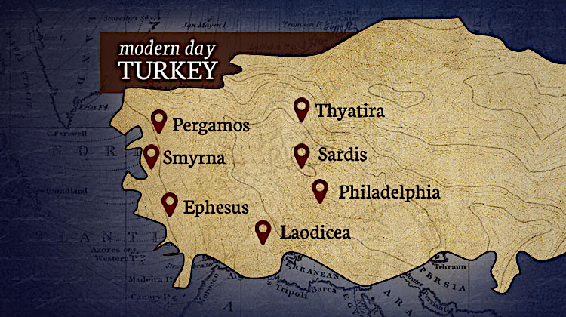
土 耳 其
推雅推喇
別迦摩
士每拿
撒狄
拉菲鐵非
以弗所
老底嘉

Slide 3
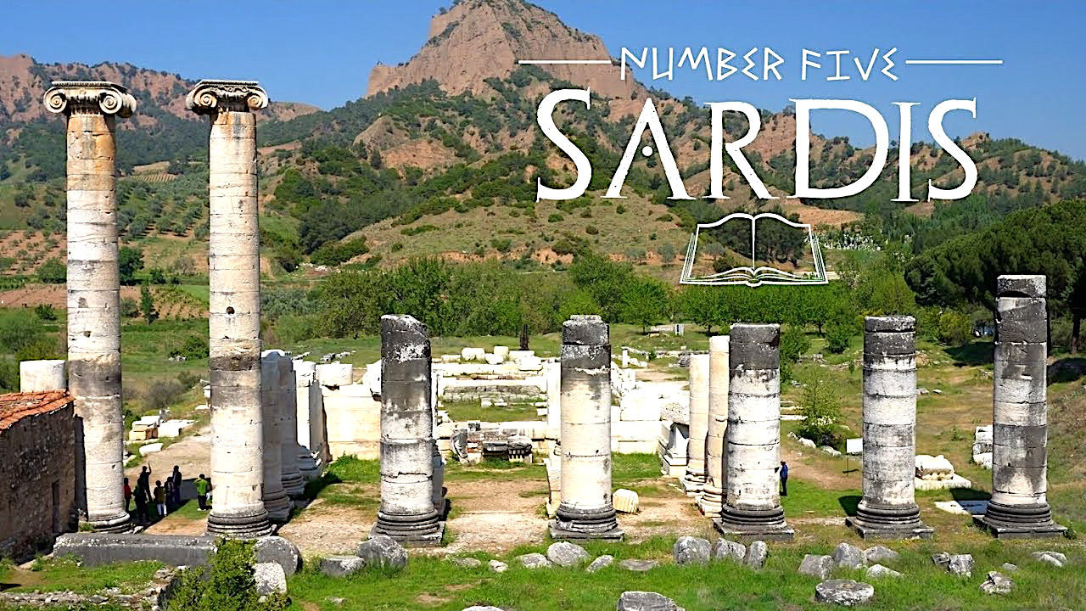
撒狄

Slide 4

启示录 3：1-2
1 “你要写信给撒狄教会的使者说：‘那有神的七灵和七星的说：我知道你的行为，按名你是活的，其实是死的。 2 你要警醒，坚固那剩下将要衰微[a]的，因我见你的行为在我神面前，没有一样是完全的。

Slide 5
Revelation 3：1-2
1 “To the angel[a] of the church in Sardis write:These are the words of him who holds the seven spirits[b] of God and the seven stars. I know your deeds; you have a reputation of being alive, but you are dead. 2 Wake up! Strengthen what remains and is about to die, for I have found your deeds unfinished in the sight of my God.

Slide 6
神的七灵和七星
Seven spirits of God and the seven starts
代表神的全知和权柄
Represent the Omniscience and Authority of God

Slide 7
名存实亡的教会如何振作？
How to revitalize a church that exists
in name only?
大前提：要认清自己的处境！
Bid premise: Be aware of your own situation!

Slide 8
不要陷入安逸舒适的光景中而不自觉
Do not fall into a comfortable situation
without realizing it.

Slide 9
启示录 3 :3
3 ‘所以要回想你是怎样领受、怎样听见的，又要遵守，并要悔改。若不警醒，我必临到你那里，如同贼一样。我几时临到，你也决不能知道。

Slide 10
Revelation 3 :3
3 Remember, therefore, what you have received and heard; hold it fast, and repent. But if you do not wake up, I will come like a thief, and you will not know at what time I will come to you.

Slide 11
1.回想与遵守。 Reflect and Obey.
2.悔改和警醒。 Repent and Alert.

Slide 12
申命记 30:15-16
15 “看哪，我今日将生与福、死与祸，陈明在你面前。
16 吩咐你爱耶和华你的神，遵行他的道，谨守他的诫命、律例、典章，使你可以存活，人数增多，耶和华你神就必在你所要进去得为业的地上，赐福于你。

Slide 13
Deuteronomy 30:15-16
15 See, I set before you today life and prosperity, death and destruction.
16 For I command you today to love the Lord your God, to walk in obedience to him, and to keep his commands, decrees and laws; then you will live and increase, and the Lord your God will bless you in the land you are entering to possess.

Slide 14
申命记 30:17-18
17 倘若你心里偏离，不肯听从，却被勾引去敬拜侍奉别神，
18 我今日明明告诉你们：你们必要灭亡！在你过约旦河进去得为业的地上，你的日子必不长久。

Slide 15
Deuteronomy 30:17-18
17 But if your heart turns away and you are not obedient, and if you are drawn away to bow down to other gods and worship them,
18 I declare to you this day that you will certainly be destroyed. You will not live long in the land you are crossing the Jordan to enter and possess.

Slide 16
申命记 30:19-20
19 我今日呼天唤地向你作见证，我将生死祸福陈明在你面前，所以你要拣选生命，使你和你的后裔都得存活。
20 且爱耶和华你的神，听从他的话，专靠他，因为他是你的生命，你的日子长久也在乎他。这样，你就可以在耶和华向你列祖亚伯拉罕、以撒、雅各起誓应许所赐的地上居住。”

Slide 17
Deuteronomy 30:19-20
19 This day I call the heavens and the earth as witnesses against you that I have set before you life and death, blessings and curses. Now choose life, so that you and your children may live
20 and that you may love the Lord your God, listen to his voice, and hold fast to him. For the Lord is your life, and he will give you many years in the land he swore to give to your fathers, Abraham, Isaac and Jacob.

Slide 18
约翰福音 10:10
10 盗贼来，无非要偷窃、杀害、毁坏；我来了，是要叫羊得生命，并且得的更丰盛。
10 The thief comes only to steal and kill and destroy; I have come that they may have life, and have it to the full.

Slide 19
雅各书 4:14-15
14 其实明天如何，你们还不知道。你们的生命是什么呢？你们原来是一片云雾，出现少时就不见了。
15 你们只当说：“主若愿意，我们就可以活着，也可以做这事或做那事。”

Slide 20
James 4:14-15
14 Why, you do not even know what will happen tomorrow. What is your life? You are a mist that appears for a little while and then vanishes.
15 Instead, you ought to say, “If it is the Lord’s will, we will live and do this or that.”

Slide 21
1.心理上的准备Psychological preparation
2.思想上的准备 Cognitive preparation
3.实际上的准备Actual preparation

Slide 22
约翰福音 9:4
4 趁着白日，我们必须做那差我来者的工；黑夜将到，就没有人能做工了。
4 As long as it is day, we must do the works of him who sent me. Night is coming, when no one can work.

Slide 23
振作從哪開始？
Where does revitalization begin?
1.回想与遵守。 Reflect and Obey.
2.悔改和警醒。 Repent and Alert.

