Slide 1

房正豪牧師

Slide 2

诗篇 Psalm 121:1-2
1 我要向山举目。我的帮助从何而来？
2 我的帮助从造天地的耶和华而来。
1 I lift up my eyes toward the mountains — from where will my help come?
2 My help is from the Lord, maker of heaven and earth.

Slide 3
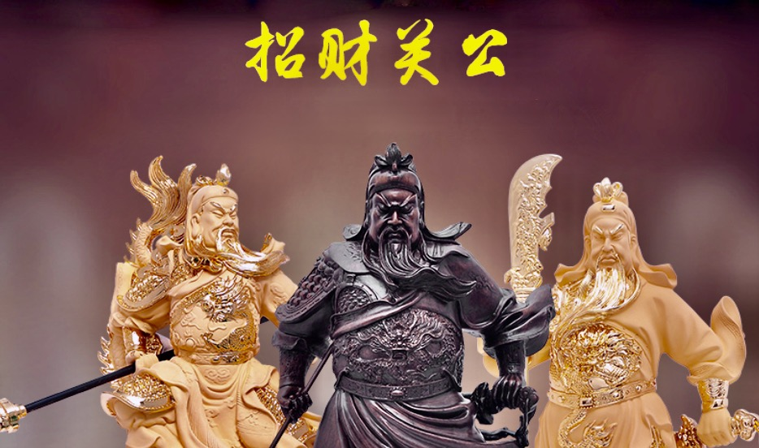
God of Wealth

Slide 4
神是创造时间空间的神
God is the God who creates time and space.
祂在时间空间以外
He is beyond the time and space.
祂也可以進入時空之內
He can also enter time and space.

Slide 5
神的同在给我们
最大的安慰和保障！
God’s presence gives us
the greatest comfort and protection.

Slide 6
诗篇 Psalm 121:3
3 他必不叫你的脚摇动，保护你的必不打盹。
3 He will never let your foot slip,
nor[b] will your guardian become drowsy.

Slide 7
诗篇 Psalm 121:4
4 保护以色列的也不打盹，也不睡觉。
4 Look! The one who is guarding Israel never sleeps and does not take naps.

Slide 8
列王記 6:16-17
16 神人说：“不要惧怕，与我们同在的比与他们同在的更多。”
17 以利沙祷告说：“耶和华啊，求你开这少年人的眼目，使他能看见。”耶和华开他的眼目，他就看见满山有火车火马围绕以利沙。

Slide 9
2 Kings 6:16-17
16 Elisha[j] replied, “Stop being afraid, because there are more with us than with them!”

Slide 10
17 Then Elisha prayed, asking the Lord, “Please make him able to really see!” And so when the Lord enabled the young man to see, he looked, and there was the mountain, filled with horses and fiery chariots surrounding Elisha!

Slide 11
诗篇 121:5-6
5 保护你的是耶和华，耶和华在你右边荫庇你。
6 白日，太阳必不伤你；夜间，月亮必不害你。

Slide 12
Psalm 121:5-6
5 The Lord is your guardian; the Lord is your shade at your right side.
6 The sun will not ravage you by day, nor the moon by night.

Slide 13
诗篇 Psalm 121:7
7 耶和华要保护你免受一切的灾害，他要保护你的性命。
7 The Lord will guard you from all evil, preserving your life.

Slide 14
希伯来书 Hebrews 13:8
8 耶稣基督昨日、今日、一直到永远，是一样的。
8 Jesus, the Messiah,[g] is the same yesterday and today—and forever!

Slide 15
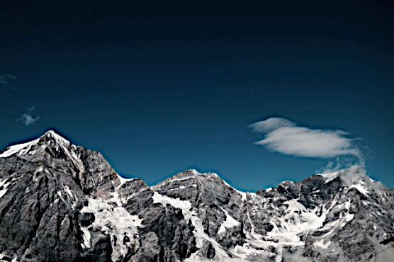
诗篇 Psalm 121:8
你出你入，耶和华要保护你，从今时直到永远。
The Lord will guard your goings and comings, from this time on and forever.

