Slide 1
如何得勝？
How to be Victorious?
房正豪牧師

Slide 2
撒母耳记上 17:10-11
10 那非利士人又说：“我今日向以色列人的军队骂阵。你们叫一个人出来，与我战斗。”
11 扫罗和以色列众人听见非利士人的这些话，就惊惶，极其害怕。

Slide 3
1 Samuel 17:10-11
10 Then the Philistine said, “This day I defy the armies of Israel! Give me a man and let us fight each other.”
11 On hearing the Philistine’s words, Saul and all the Israelites were dismayed and terrified.

Slide 4
撒母耳记上 17:26
大卫问站在旁边的人说：“有人杀这非利士人，除掉以色列人的耻辱，怎样待他呢？这未受割礼的非利士人是谁呢？竟敢向永生神的军队骂阵吗？”

Slide 5
1 Samuel 17:26
David asked the men standing near him, “What will be done for the man who kills this Philistine and removes this disgrace from Israel? Who is this uncircumcised Philistine that he should defy the armies of the living God?”

Slide 6
單純對神的信心，
產生強大的力量。
Genuine Faith in God,
Will Produce Great Power.

Slide 7
提摩太后书 2 Timothy 1:7
因为神赐给我们不是胆怯的心，乃是刚强、仁爱、谨守的心。
For the Spirit God gave us does not make us timid, but gives us power, love and self-discipline.

Slide 8
得勝的秘訣：
The Secrets of Victory:
1.要靠神的話語。
Rely on the Word of God.
2.要靠神的靈。
Rely on the Spirit of God.
3.要靠平常的操練。
Rely on Consistent Practice.

Slide 9
加拉太书 Galatians 6:7-8
7 不要自欺，神是轻慢不得的。人种的是什么，收的也是什么。
8 顺着情欲撒种的，必从情欲收败坏；顺着圣灵撒种的，必从圣灵收永生。

Slide 10
加拉太书 Galatians 6:7-8
7 Do not be deceived: God cannot be mocked. A man reaps what he sows.
8 Whoever sows to please their flesh, from the flesh will reap destruction; whoever sows to please the Spirit, from the Spirit will reap eternal life.

Slide 11
加拉太书 Galatians 5:25
我们若是靠圣灵得生，就当靠圣灵行事。
Since we live by the Spirit, let us keep in step with the Spirit.

Slide 12
臨危不亂，沈穩應戰！
Undaunted in the Face of Danger,
Calm before the Battle!

Slide 13
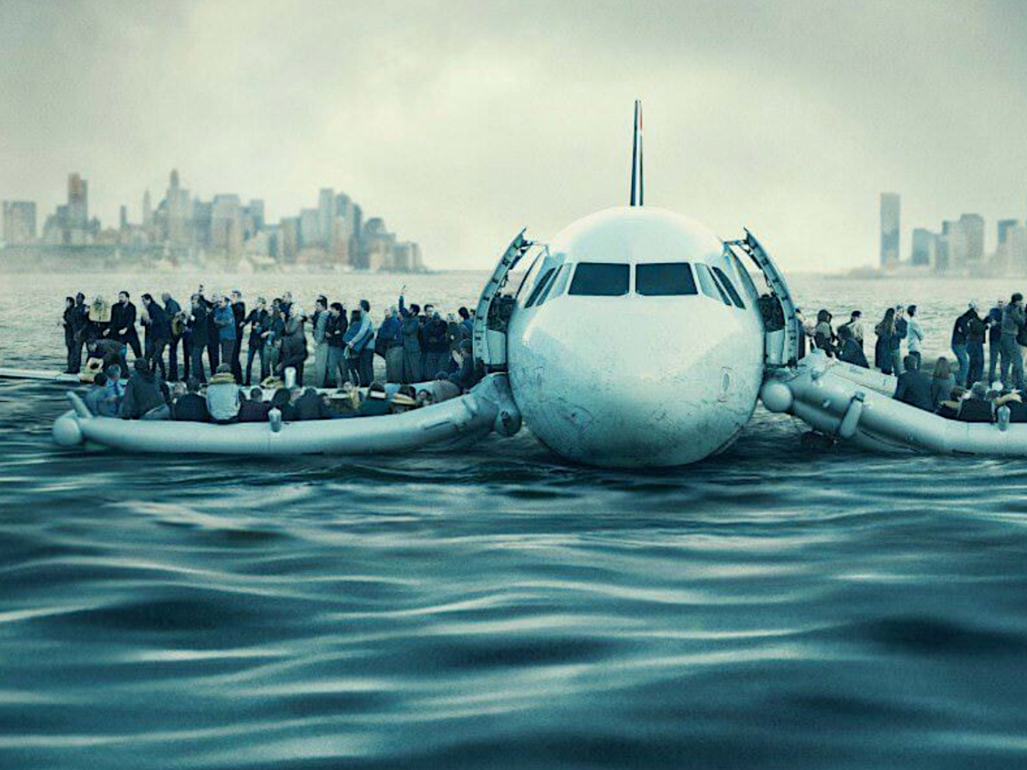
紐約哈德遜河上的奇蹟

Slide 14
如何得胜？
How to be Victorious?
1.全心信靠神。
Trusting God Entirely.
a:靠主得胜，恐惧，忧虑，
怀疑。
Rely on the Lord to Overcome Fear, Anxiety, and Suspicion.

Slide 15
b:靠主得胜撒旦的诱惑，
世界的迷惑。
Rely on the Lord to Overcome Satan’s Temptation, and the World’s Illusion.

Slide 16
2.平常需要殷勤的操练！
Be Attentive to Your Training.
a:生命与主联合。
Unite with the Lord.
b:生活与主同行。
Walk with the Lord.

