Slide 1
房正豪牧師

Slide 2
罗马书 1:28-32 28 他们既然故意不认识神，神就任凭他们存邪僻的心，行那些不合理的事：
29 装满了各样不义、邪恶、贪婪、恶毒；满心是嫉妒、凶杀、争竞、诡诈、毒恨；

Slide 3
30 又是谗毁的、背后说人的、怨恨神的、侮慢人的、狂傲的、自夸的、捏造恶事的、违背父母的、 31 无知的、背约的、无亲情的、不怜悯人的。
32 他们虽知道神判定行这样事的人是当死的，然而他们不但自己去行，还喜欢别人去行。

Slide 4
Romans 1:28-32
28 Furthermore, because they did not think it worthwhile to keep knowing God fully, God delivered them to degraded minds to perform acts that should not be done.

Slide 5
29 They have become filled with every kind of wickedness, evil, greed, and depravity. They are full of envy, murder, quarreling, deceit, and viciousness. They are gossips,

Slide 6
30 slanderers, God-haters, haughty, arrogant, boastful, inventors of evil, disobedient to their parents,
31 foolish, faithless, heartless, and ruthless.

Slide 7
32 Although they know God’s just requirement—that those who practice such things deserve to die—they not only do these things but even applaud others who practice them.

Slide 8
罗马书 1:32 32 他们虽知道神判定行这样事的人是当死的，然而他们不但自己去行，还喜欢别人去行。

Slide 9
Romans 1:32 32 Although they know God’s just requirement—that those who practice such things deserve to die—they not only do these things but even applaud others who practice them.

Slide 10
罗马书 2:1-3 1 你这论断人的，无论你是谁，也无可推诿。你在什么事上论断人，就在什么事上定自己的罪，因你这论断人的，自己所行却和别人一样。 2 我们知道这样行的人，神必照真理审判他。

Slide 11
3 你这人哪，你论断行这样事的人，自己所行的却和别人一样，你以为能逃脱神的审判吗？

Slide 12
Romans 2:1-3
1 Therefore, you have no excuse—every one of you who judges. For when you pass judgment on another person, you condemn yourself, since you, the judge, practice the very same things.

Slide 13
2 Now we know that God’s judgment against those who act like this is based on[a] truth.
3 So when you, a mere man, pass judgment on those who practice these things and then do them yourself, do you think you will escape God’s judgment?

Slide 14
罗马书 2:4-8 4 还是你藐视他丰富的恩慈、宽容、忍耐，不晓得他的恩慈是领你悔改呢？
5 你竟任着你刚硬不悔改的心，为自己积蓄愤怒，以致神震怒，显他公义审判的日子来到。

Slide 15
6 他必照各人的行为报应各人。
7 凡恒心行善，寻求荣耀、尊贵和不能朽坏之福的，就以永生报应他们；
8 唯有结党、不顺从真理反顺从不义的，就以愤怒、恼恨报应他们。

Slide 16
Romans 2:4-8
4 Or are you unaware of his rich kindness, forbearance, and patience, that it is God’s kindness that is leading you to repent?

Slide 17
5 But because of your stubborn and unrepentant heart you are reserving wrath for yourself on the day of wrath, when God’s righteous judgment will be revealed. 6 For he will repay everyone according to what that person has done:

Slide 18
7 eternal life to those who strive for glory, honor, and immortality by patiently doing good;
8 but wrath and fury for those who in their selfish pride refuse to believe the truth and practice wickedness instead.

Slide 19
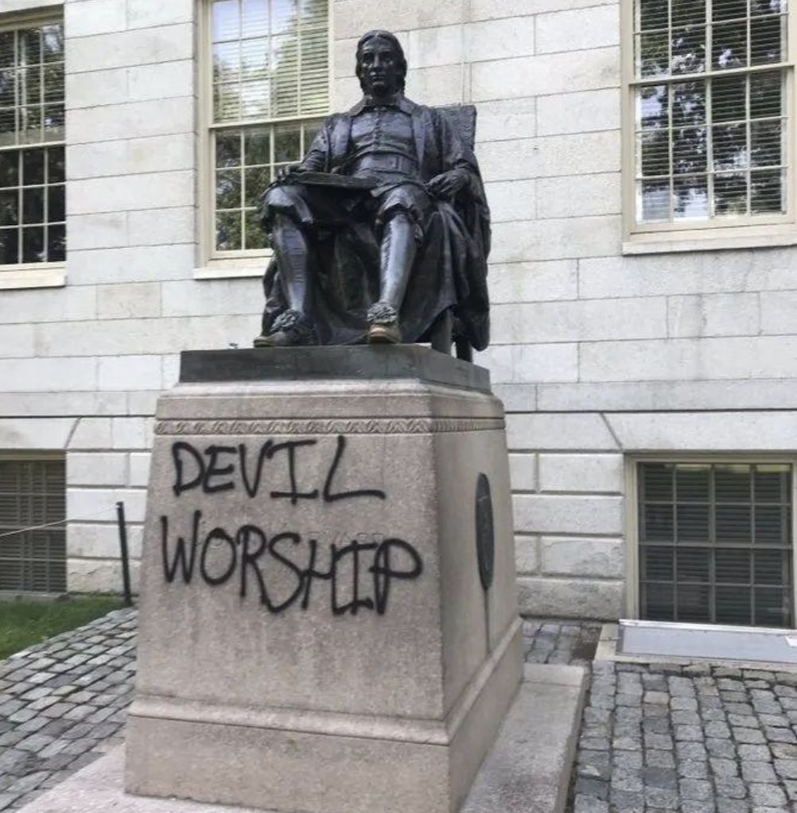

Slide 20
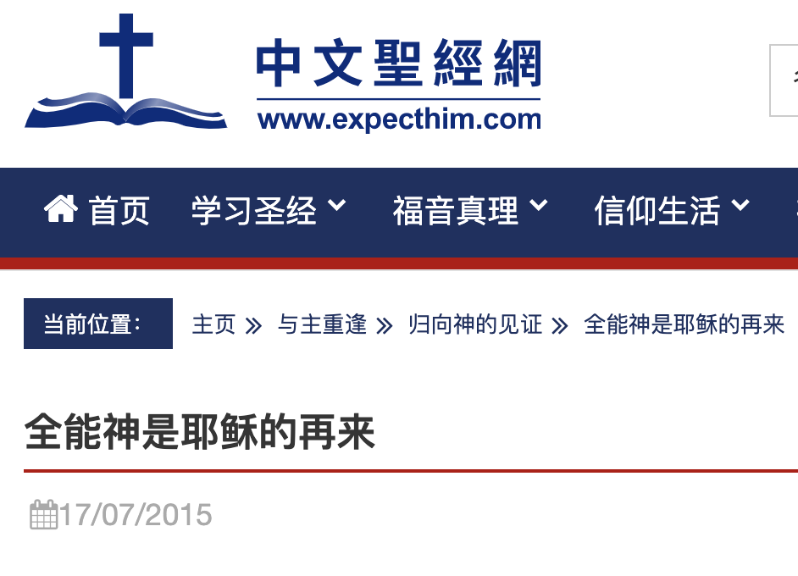

Slide 21
真光影視工作室
小品、電視劇、電影
（全能神，異端）
The True Light Video and Audio Workshop
Skits, Soup Operas Movies
(So called " Almight God" Heresy)

Slide 22
判斷和論斷是不同的
Pass judgement on others is different the simple and pure judgement

