Slide 1
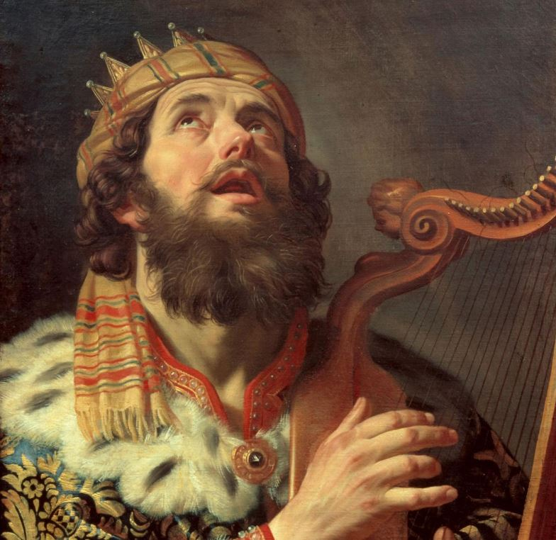
領袖的特質
Traits of a Leader
房正豪牧師

Slide 2
撒母耳记上 30:6-8
6 大卫甚是焦急，
因众人为自己的儿女苦恼，
说要用石头打死他。
大卫却倚靠耶和华他的神，心里坚固。

Slide 3
撒母耳记上 30:6-8
7 大卫对亚希米勒的儿子祭司亚比亚他说：“请你将以弗得拿过来。”亚比亚他就将以弗得拿到大卫面前。

Slide 4
撒母耳记上 30:6-8
8 大卫求问耶和华说：“我追赶敌军，追得上追不上呢？”耶和华说：“你可以追，必追得上，都救得回来。”

Slide 5
1 Samuel 30:6-8
6 David was greatly distressed because the men were talking of stoning him; each one was bitter in spirit because of his sons and daughters. But David found strength in the Lord his God.

Slide 6
1 Samuel 30:6-8
7 Then David said to Abiathar the priest, the son of Ahimelek, “Bring me the ephod.” Abiathar brought it to him,

Slide 7
1 Samuel 30:6-8
8 and David inquired of the Lord, “Shall I pursue this raiding party? Will I overtake them?”
“Pursue them,” he answered. “You will certainly overtake them and succeed in the rescue.”

Slide 8
1.臨危不亂，全心依靠神。
Stay Calm in the Lord
when Facing Crisis!

Slide 9
撒母耳记上 1 Samuel 30:8
8 大卫求问耶和华说：“我追赶敌军，追得上追不上呢？”耶和华说：“你可以追，必追得上，都救得回来。”

Slide 10
撒母耳记上 1 Samuel 30:8
8 and David inquired of the Lord, “Shall I pursue this raiding party? Will I overtake them?”
“Pursue them,” he answered. “You will certainly overtake them and succeed in the rescue.”

Slide 11
群眾可以激動，領袖卻要冷靜。
Others may Get Excited,
but a Leader must Stay Calm.
群眾可以血氣，領袖卻要屬靈。
Some may Act on Impulse,
but a Leader Follow the Holy Spirit.

Slide 12
耶利米书 29:13
13 你们寻求我，若专心寻求我，就必寻见。
13 You will seek me and find me when you seek me with all your heart.

Slide 13
撒母耳记上 30:23-25
23 大卫说：“弟兄们，耶和华所赐给我们的，不可不分给他们，因为他保佑我们，将那攻击我们的敌军交在我们手里。

Slide 14
24 这事谁肯依从你们呢？上阵的得多少，看守器具的也得多少，应当大家平分。”
25 大卫定此为以色列的律例、典章，从那日直到今日。

Slide 15
1 Samuel 30:23-25
23 David replied, “No, my brothers, you must not do that with what the Lord has given us. He has protected us and delivered into our hands the raiding party that came against us.

Slide 16
24 Who will listen to what you say? The share of the man who stayed with the supplies is to be the same as that of him who went down to the battle. All will share alike.”
25 David made this a statute and ordinance for Israel from that day to this.

Slide 17
2.对人公平，处事老练！
Be Fair when Dealing with People!

Slide 18
恩慈相待是我們要學習的。
Be kind each other.

Slide 19
3. 生活圣潔， 征战有力！
Live in Holiness will
Give You Strength!

Slide 20
神培養领袖有三个阶段。
God's 3-Phase Process to Leadership.
1：有神清楚的呼召！
God's Calling is Clear.
2：愿意接受良好的训练！
Willingness to be Equipped.
3：决心执行神交代的任务！
Determine to Execute God's Order.

Slide 21
提摩太后书 2:1-2
1 我儿啊，你要在基督耶稣的恩典上刚强起来。
2 你在许多见证人面前听见我所教训的，也要交托那忠心能教导别人的人。

Slide 22
2 Timothy 2:1-2
1.You then, my son, be strong in the grace that is in Christ Jesus.
2. And the things you have heard me say in the presence of many witnesses entrust to reliable people who will also be qualified to teach others.

Slide 23
领袖的特质三个重点。
3 key points for leader's traits
1.临危不乱，靠主镇定！
Stay Calm in the Lord when Facing Crisis!
2.对人公平，处事老练！
Be Fair when Dealing with People!
3.生活圣潔，征战有力！
Live in Holiness will Give You Strength!

