Slide 1
Torah
history book
Psalms Wisdom
Great Prophets
Minor Prophets
Rev. Steven Fang 房正豪牧师

Slide 2
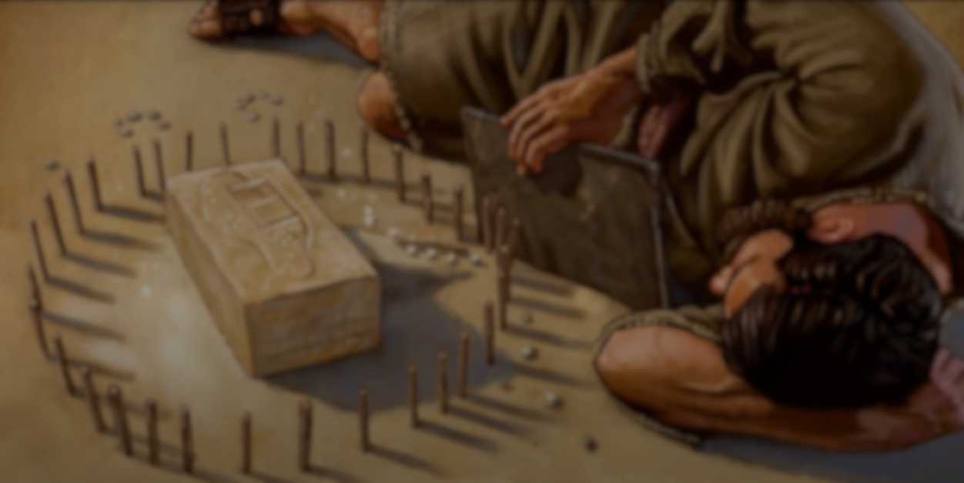
以西结书 Ezekiel 4:1~3
1 人子啊，你要拿一块砖，摆在你面前，将一座耶路撒冷城画在其上，
1 “Now, son of man, take a block of clay, put it in front of you and draw the city of Jerusalem on it.

Slide 3
2 又围困这城，造台筑垒，安营攻击，在四围安设撞锤攻城
2 Then lay siege to it: Erect siege works against it, build a ramp up to it, set up camps against it and put battering rams around it. ，

Slide 4
3 又要拿个铁鏊，放在你和城的中间，作为铁墙。你要对面攻击这城，使城被困。这样，好作以色列家的预兆。
3 Then take an iron pan, place it as an iron wall between you and the city and turn your face toward it. It will be under siege, and you shall besiege it. This will be a sign to the people of Israel.

Slide 5
马太福音 Matthew 24:6~8
6 你们也要听见打仗和打仗的风声，总不要惊慌。因为这些事是必须有的。只是末期还没有到。
6 You will hear of wars and rumors of wars, but see to it that you are not alarmed. Such things must happen, but the end is still to come.

Slide 6
7 民要攻打民，国要攻打国。多处必有饥荒，地震。
7 Nation will rise against nation, and kingdom against kingdom. There will be famines and earthquakes in various places.
8 这都是灾难的起头。
8 All these are the beginning of birth pains.

Slide 7
神愿意先警告我们， God wants to warn us first,
那怎么办？
So what to do?

Slide 8
我们把握三原则
We follow three principles
1.坚守信仰 Hold fast to the faith 2.积极事奉 Active ministry 3.传扬福音 Preach the Gospel

Slide 9
以西结书 Ezekiel 4:4~6
4 你要向左侧卧，承当以色列家的罪孽。要按你向左侧卧的日数，担当他们的罪孽。
4 “Then lie on your left side and put the sin of the people of Israel upon yourself.[a] You are to bear their sin for the number of days you lie on your side..

Slide 10
5 因为我已将他们作孽的年数定为你向左侧卧的日数，就是三百九十日，你要这样担当以色列家的罪孽。
5 I have assigned you the same number of days as the years of their sin. So for 390 days you will bear the sin of the people of Israel.

Slide 11
6 再者，你满了这些日子，还要向右侧卧，担当犹大家的罪孽。我给你定规侧卧四十日，一日顶一年。
6 “After you have finished this, lie down again, this time on your right side, and bear the sin of the people of Judah. I have assigned you 40 days, a day for each year.

Slide 12
大家要把握事奉神的机会！
Everyone must seize the opportunity to serve God!

Slide 13
申命记 Deuteronomy 10:12
以色列啊，现在耶和华你神向你所要的是什么呢？只要你敬畏耶和华你的神，遵行他的道，爱他，尽心尽性事奉他，
And now, Israel, what does the Lord your God ask of you but to fear the Lord your God, to walk in obedience to him, to love him, to serve the Lord your God with all your heart and with all your soul,

Slide 14
1.敬畏神
Fear God 2.遵行神的道
Obey God’s will 3.要爱神
Love God 4.尽心事奉神
Serve God with all your heart

Slide 15
我们学到什么？
What do we learn? 坚忍！
Stoic!

Slide 16
坚持忍耐
persist in patience 完成任务
mission accomplished

Slide 17
腓利比书 Philippians 4:13
我靠着那加给我力量的，凡事都能作。
I can do all this through him who gives me strength.

Slide 18
腓利比书 Philippians 4:12
我知道怎样处卑贱，也知道怎样处丰富，或饱足，或饥饿，或有余，或缺乏，随事随在，我都得了秘诀。
I know what it is to be in need, and I know what it is to have plenty. I have learned the secret of being content in any and every situation, whether well fed or hungry, whether living in plenty or in want.

Slide 19
腓利比书 Philippians 4:13-14
13 我靠着那加给我力量的，凡事都能作。13 I can do all this through him who gives me strength.
14 然而你们和我同受患难，原是美事。
14 Yet it was good of you to share in my troubles.

Slide 20
事奉总有酸甜苦辣
There are always ups and downs in serving 总要坚忍到底
Always endure to the end

Slide 21
老手带新人
The old hand leads the newcomer 全人关怀，造就他。 Whole-hearted care makes him.

Slide 22
事奉主的道路上
On the way to serve the Lord 我们一起走！ 加油！
let's go together! come on!

