Slide 1
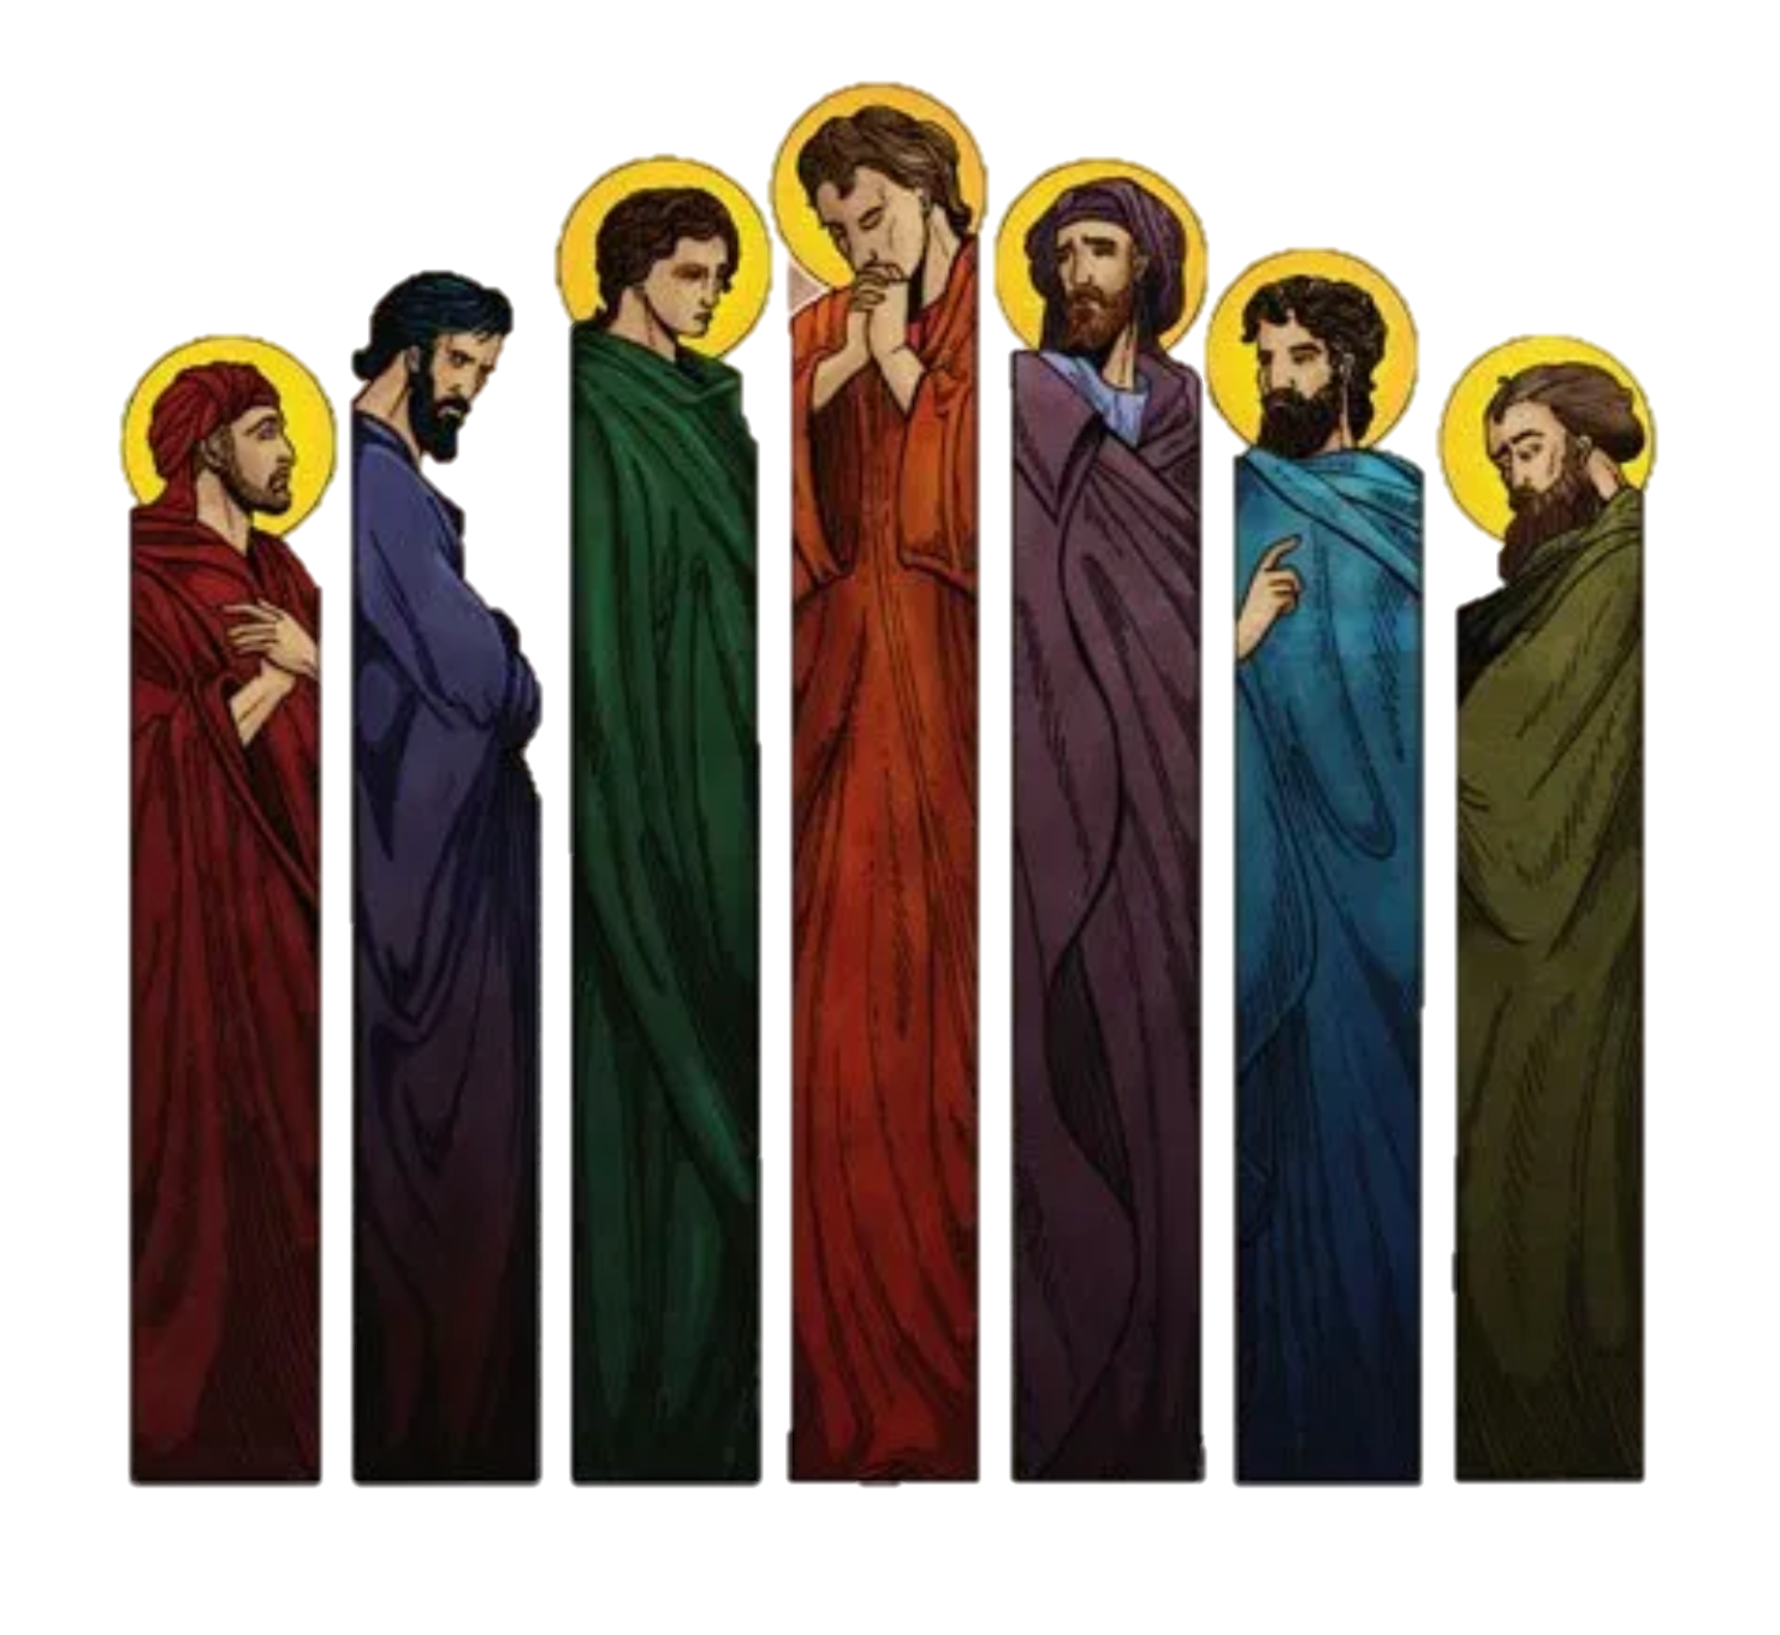
我們的盼望
Our hope
房正豪牧師

Slide 2
使徒行傳 6
1 那时，门徒增多，有说希腊话的犹太人向希伯来人发怨言，因为在天天的供给上忽略了他们的寡妇。

Slide 3
Acts 6
1 In those days when the number of disciples was increasing, the Hellenistic Jews[a] among them complained against the Hebraic Jews because their widows were being overlooked in the daily distribution of food.

Slide 4
使徒行傳 6
2 十二使徒叫众门徒来，对他们说：“我们撇下神的道去管理饭食，原是不合宜的。
3 所以弟兄们，当从你们中间选出七个有好名声、被圣灵充满、智慧充足的人，我们就派他们管理这事。

Slide 5
使徒行傳 6
4 但我们要专心以祈祷、传道为事。
5 大众都喜悦这话，就拣选了司提反，乃是大有信心、圣灵充满的人；又拣选腓利、伯罗哥罗、尼迦挪、提门、巴米拿，并进犹太教的安提阿人尼哥拉。

Slide 6
Acts 6
2 So the Twelve gathered all the disciples together and said, “It would not be right for us to neglect the ministry of the word of God in order to wait on tables.

Slide 7
Acts 6
3 Brothers and sisters, choose seven men from among you who are known to be full of the Spirit and wisdom. We will turn this responsibility over to them
4 and will give our attention to prayer and the ministry of the word.”

Slide 8
Acts 6
5 This proposal pleased the whole group. They chose Stephen, a man full of faith and of the Holy Spirit; also Philip, Procorus, Nicanor, Timon, Parmenas, and Nicolas from Antioch, a convert to Judaism.

Slide 9
管理飯食的人
1.要有好名声。
2.要被圣灵充满。
3.要智慧充足。

Slide 10
Those Who are Responsible
to Wait on Tables.
1.Must Be Known by All
2. Must be Filled by the Spirit
3.Must be Full of Wisdom

Slide 11
使徒行傳 Acts 6
5 大众都喜悦这话，就拣选了司提反，乃是大有信心、圣灵充满的人；又拣选腓利、伯罗哥罗、尼迦挪、提门、巴米拿，并进犹太教的安提阿人尼哥拉。
This proposal pleased the whole group. They chose Stephen, a man full of faith and of the Holy Spirit; also Philip, Procorus, Nicanor, Timon, Parmenas, and Nicolas from Antioch,
a convert to Judaism.

Slide 12
七位弟兄都非常看重這職分!所以接受!
Seven Brothers Accepted Their Appointment!

Slide 13
灵粮、食粮
雙粮齊下
羊群健康又強壯
The Flock is Healthy & Strong when They are Well-fed Spiritually & Physically.

Slide 14
教會行政三重點
Church Administration Focuses
on the Following
1:组织简单。
Simple Organization

Slide 15
1:组织简单。
Simple Organization
2:良好交流。
Great Communication

Slide 16
1:组织简单。
Simple Organization
2:良好交流。
Great Communication
3:目标清楚。
Clear Goals

Slide 17
教會資源評估
靈力
人力
財力
物力
選召領袖
各盡其才
帶領計畫
誰帶誰？
何時啟動
五年目標
2/3 每日靈修
2/3 做主門徒
1/3 禱告會
達成事工目標

Slide 18
Evaluation of church resources
Power of spiritual
Human
Financial Material
Select leaders,
Do their best,
Leadership plan,
Who lead who ?
When to start.
5 years goal
3/2 daily devotion,
3/2 being disciples,
3/1 join prayer meeting,
To reach goals.

Slide 19
三人行必有我師
If Three Walk Together,
One of Them can Teach Me Something!

Slide 20
討主喜悅的教會
A Church that Pleases the Lord
1.必定是合一的教會。
Must be One that is Syncretic
2.必定是追求真理的教會。
Must be One that Seeks After Truth
3.必定是傳福音的教會。
Must be One that Evangelize

Slide 21
腓立比书 4
13 我靠着那加给我力量的，凡事都能做。
I can do all this through him who gives me strength.

Slide 22
使徒行传 Acts 6
7 神的道兴旺起来，在耶路撒冷门徒数目加增的甚多，也有许多祭司信从了这道。
So the word of God spread. The number of disciples in Jerusalem increased rapidly, and a large number of priests became obedient to the faith.

Slide 23
羅馬書 Romans 15
13 但愿使人有盼望的神，因信将诸般的喜乐、平安充满你们的心，使你们借着圣灵的能力大有盼望！
May the God of hope fill you with all joy and peace as you trust in him, so that you may overflow with hope by the power of the Holy Spirit.

Slide 24
教會行政三重點
Church Management
1.组织简单，分工清楚。
Simple Organization Clarifies Job Roles.

Slide 25
1.组织简单，分工清楚。
Simple Organization Clarifies Job Roles.
2.良好交流，减少误会。
Great Communication Reduces Misunderstanding.

Slide 26
1.组织简单，分工清楚。
Simple Organization Clarifies Job Roles.
2.良好交流，减少误会。
Great Communication Reduces Misunderstanding.
3.目标清楚，知人善用。
Set Clear Goals, then Assign Works that Commensurate with their Abilities.

