Slide 1
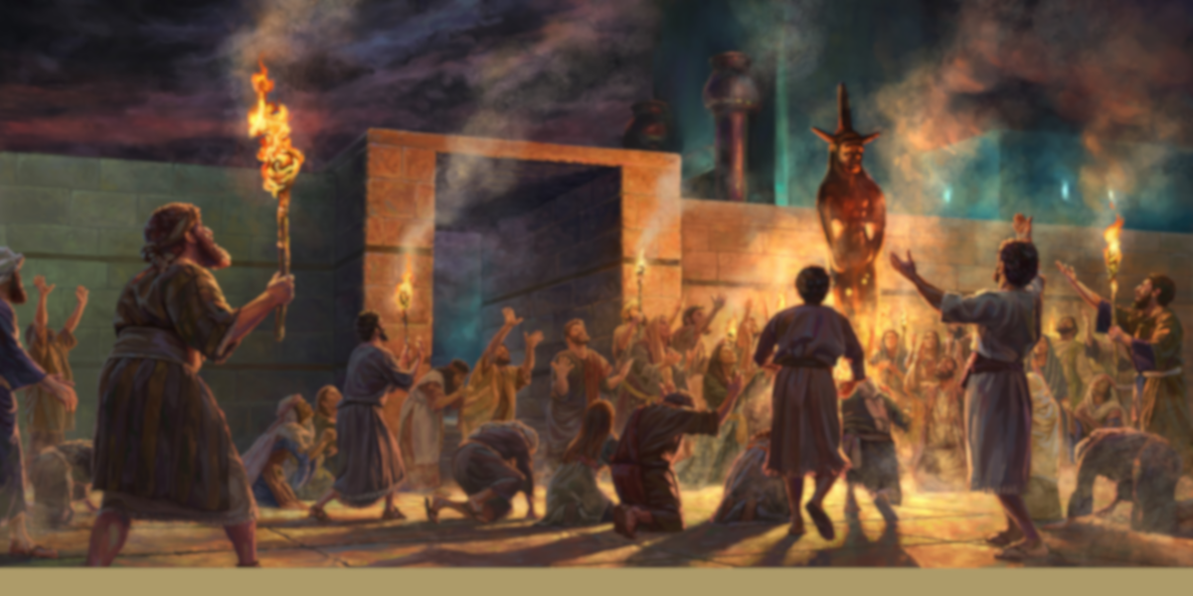
隐 密 的 罪
Hidden sin
Rev. Steven Fang
房正豪牧师

Slide 2
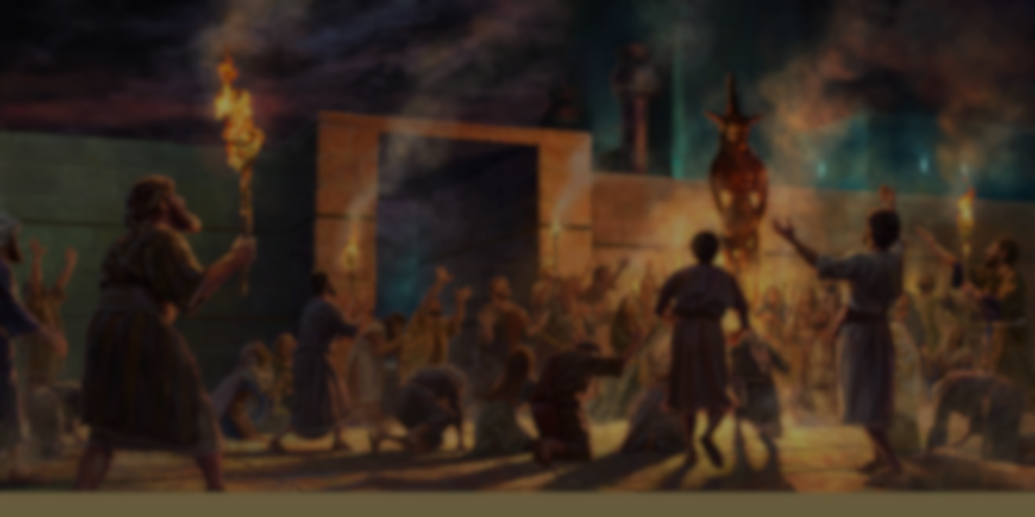
拜偶像 Idolatry 拜画像 Worship images 拜性慾的神 God of sexuality 拜太阳 Worship the sun

Slide 3
以西结书 Ezekiel 8:5-6
5 神对我说，人子啊，你举目向北观看。我就举目向北观看，见祭坛门的北边在门口有这惹忌邪的偶像。
5 Then he said to me, “Son of man, look toward the north.” So I looked, and in the entrance north of the gate of the altar I saw this idol of jealousy.

Slide 4
6 又对我说，人子啊，以色列家所行的，就是在此行这大可憎的事，使我远离我的圣所，你看见了吗？你还要看见另有大可憎的事。
6 And he said to me, “Son of man, do you see what they are doing—the utterly detestable things the Israelites are doing here, things that will drive me far from my sanctuary? But you will see things that are even more detestable

Slide 5
出埃及记 Exodus 20:1-3
1 神吩咐这一切的话说，
2 我是耶和华你的神，曾将你从埃及地为奴之家领出来。
3 除了我以外，你不可有别的神。
1 And God spoke all these words:
2 “I am the Lord your God, who brought you out of Egypt, out of the land of slavery.
3 “You shall have no other gods before me.

Slide 6
申命记 Deuteronomy 4:23-24
23 你们要谨慎，免得忘记耶和华你们神与你们所立的约，为自己雕刻偶像，就是耶和华你神所禁止你作的偶像。
24 因为耶和华你的神乃是烈火，是忌邪的神。
23 Be careful not to forget the covenant of the Lord your God that he made with you; do not make for yourselves an idol in the form of anything the Lord your God has forbidden. 24 For the Lord your God is a consuming fire, a jealous God.

Slide 7
以西结书 Ezekiel 8:7-9
7 他领我到院门口。我观看，见墙上有个窟窿。
8 他对我说，人子啊，你要挖墙。我一挖墙，见有一门。
9 他说，你进去，看他们在这里所行可憎的恶事。
7 Then he brought me to the entrance to the court. I looked, and I saw a hole in the wall.
8 He said to me, “Son of man, now dig into the wall.” So I dug into the wall and saw a doorway there.
9 And he said to me, “Go in and see the wicked and detestable things they are doing here.”

Slide 8
以西结书 Ezekiel 8:10-11
10 我进去一看，谁知，在四面墙上画着各样爬物和可憎的走兽，并以色列家一切的偶像。
11 在这些像前有以色列家的七十个长老站立，沙番的儿子雅撒尼亚也站在其中。各人手拿香炉，烟云的香气上腾。
10 So I went in and looked, and I saw portrayed all over the walls all kinds of crawling things and unclean animals and all the idols of Israel.
11 In front of them stood seventy elders of Israel, and Jaazaniah son of Shaphan was standing among them. Each had a censer in his hand, and a fragrant cloud of incense was rising.

Slide 9
耶利米书 Jeremiah 17:9-10
9 人心比万物都诡诈，坏到极处，谁能识透呢？
10 我耶和华是鉴察人心，试验人肺腑的，要照各人所行的和他作事的结果报应他。
9 The heart is deceitful above all things and beyond cure. Who can understand it?
10 “I the Lord search the heart and examine the mind, to reward each person according to their conduct, according to what their deeds deserve.”

Slide 10
以西结书 Ezekiel 8:14-15
14 他领我到耶和华殿外院朝北的门口。谁知，在那里有妇女坐着，为搭模斯哭泣。
15 他对我说，人子啊，你看见了吗？你还要看见比这更可憎的事。
14 Then he brought me to the entrance of the north gate of the house of the Lord, and I saw women sitting there, mourning the god Tammuz.
15 He said to me, “Do you see this, son of man? You will see things that are even more detestable than this.”

Slide 11
希伯来书 Hebrews 10:25
25 你们不可停止聚会，好像那些停止惯了的人，倒要彼此劝勉。既知道那日子临近，就更当如此。
25 not giving up meeting together, as some are in the habit of doing, but encouraging one another—and all the more as you see the Day approaching.

Slide 12
以西结书 Ezekiel 8:16-18
16 他又领我到耶和华殿的内院。谁知，在耶和华的殿门口，廊子和祭坛中间，约有二十五个人背向耶和华的殿，面向东方拜日头。
16 He then brought me into the inner court of the house of the Lord, and there at the entrance to the temple, between the portico and the altar, were about twenty-five men. With their backs toward the temple of the Lord and their faces toward the east, they were bowing down to the sun in the east.

Slide 13
以西结书 Ezekiel 8:16-18
17 他对我说，人子啊，你看见了吗？犹大家在此行这可憎的事还算为小吗？他们在这地遍行强暴，再三惹我发怒，他们手拿枝条举向鼻前。
17 He said to me, “Have you seen this, son of man? Is it a trivial matter for the people of Judah to do the detestable things they are doing here? Must they also fill the land with violence and continually arouse my anger? Look at them putting the branch to their nose!

Slide 14
以西结书 Ezekiel 8:16-18
18 因此，我也要以忿怒行事，我眼必不顾惜，也不可怜他们。他们虽向我耳中大声呼求，我还是不听。18 Therefore I will deal with them in anger; I will not look on them with pity or spare them. Although they shout in my ears, I will not listen to them.”

Slide 15
箴言 Proverbs 28:13
13 遮掩自己罪过的，必不亨通。承认离弃罪过的，必蒙怜恤。
13 Whoever conceals their sins does not prosper,
but the one who confesses and renounces them finds mercy.

Slide 16
约翰一书 1 John 1:5
9 我们若认自己的罪，神是信实的，是公义的，必要赦免我们的罪，洗净我们一切的不义。
9 If we confess our sins, he is faithful and just and will forgive us our sins and purify us from all unrighteousness.

