Slide 1
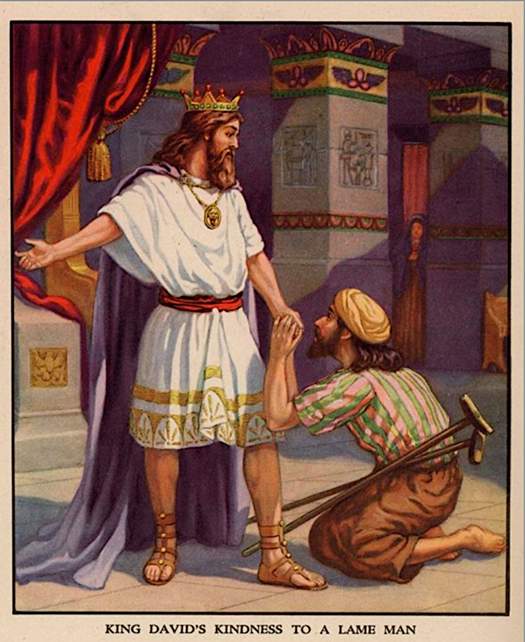
米非波設的啟發Inspiration of Mephibosheth

Slide 2
撒母耳記下 9:7-8
7 大卫说：“你不要惧怕，我必因你父亲约拿单的缘故施恩于你，将你祖父扫罗的一切田地都归还你。你也可以常与我同席吃饭。”
8 米非波设又叩拜，说：“仆人算什么，不过如死狗一般，竟蒙王这样眷顾！”

Slide 3
2 Samuel 9:7-8
7 “Don’t be afraid,” David said to him, “for I will surely show you kindness for the sake of your father Jonathan. I will restore to you all the land that belonged to your grandfather Saul, and you will always eat at my table.”

Slide 4
2 Samuel 9:7-8
8 Mephibosheth bowed down and said, “What is your servant, that you should notice a dead dog like me?”

Slide 5
人物關係圖表
掃羅王
約拿單
（僕人總管）
15 兒子，20 僕人
米非波設
洗 巴
（服 事）

Slide 6
Character Relationship Chart
Saul
Jonathan
（Servant Master）
15 Sons, 20 Servants
Mephibosheth
Ziba
Service

Slide 7
撒母耳記下 9:9-10
9 王召了扫罗的仆人洗巴来，对他说：“我已将属扫罗和他的一切家产都赐给你主人的儿子了。
10 你和你的众子、仆人，要为你主人的儿子米非波设耕种田地，把所产的拿来供他食用，他却要常与我同席吃饭。”洗巴有十五个儿子，二十个仆人。

Slide 8
2 Samuel 9:9-10
9 Then the king summoned Ziba, Saul’s steward, and said to him, “I have given your master’s grandson everything that belonged to Saul and his family.

Slide 9
2 Samuel 9:9-10
10 You and your sons and your servants are to farm the land for him and bring in the crops, so that your master’s grandson may be provided for. And Mephibosheth, grandson of your master, will always eat at my table.” (Now Ziba had fifteen sons and twenty servants.)

Slide 10
撒母耳記下 16:3-4
3 王问说：“你主人的儿子在哪里呢？”洗巴回答王说：“他仍在耶路撒冷，因他说：‘以色列人今日必将我父的国归还我。’”
4 王对洗巴说：“凡属米非波设的都归你了。”洗巴说：“我叩拜我主我王，愿我在你眼前蒙恩！”

Slide 11
2 Samuel 16:3-4
3 The king then asked, “Where is your master’s grandson?”
Ziba said to him, “He is staying in Jerusalem, because he thinks, ‘Today the Israelites will restore to me my grandfather’s kingdom.’”

Slide 12
2 Samuel 16:3-4
4 Then the king said to Ziba, “All that belonged to Mephibosheth is now yours.”
“I humbly bow,” Ziba said. “May I find favor in your eyes, my lord the king.”

Slide 13
撒母耳記下 19:24-26
24 扫罗的孙子米非波设也下去迎接王。他自从王去的日子，直到王平平安安地回来，没有修脚，没有剃胡须，也没有洗衣服。
25 他来到耶路撒冷迎接王的时候，王问他说：“米非波设，你为什么没有与我同去呢？”

Slide 14
撒母耳記下 19:24-26
26 他回答说：“我主我王，仆人是瘸腿的。那日我想要备驴骑上，与王同去，无奈我的仆人欺哄了我，

Slide 15
2 Samuel 19:24-26
24 Mephibosheth, Saul’s grandson, also went down to meet the king. He had not taken care of his feet or trimmed his mustache or washed his clothes from the day the king left until the day he returned safely.

Slide 16
2 Samuel 19:24-26
25 When he came from Jerusalem to meet the king, the king asked him, “Why didn’t you go with me, Mephibosheth?”

Slide 17
2 Samuel 19:24-26
26 He said, “My lord the king, since I your servant am lame, I said, ‘I will have my donkey saddled and will ride on it, so I can go with the king.’ But Ziba my servant betrayed me.

Slide 18
撒母耳記下 19:27-28
27 又在我主我王面前谗毁我。然而我主我王如同神的使者一般，你看怎样好，就怎样行吧。
28 因为我祖全家的人，在我主我王面前都算为死人，王却使仆人在王的席上同人吃饭。我现在向王还能辨理诉冤吗？”

Slide 19
2 Samuel 19:27-28
27 And he has slandered your servant to my lord the king. My lord the king is like an angel of God; so do whatever you wish.

Slide 20
2 Samuel 19:27-28
28 All my grandfather’s descendants deserved nothing but death from my lord the king, but you gave your servant a place among those who eat at your table. So what right do I have to make any more appeals to the king?”

Slide 21
撒母耳記下 19:29-30
29 王对他说：“你何必再提你的事呢？我说：你与洗巴均分地土。”
30 米非波设对王说：“我主我王既平平安安地回宫，就任凭洗巴都取了也可以。”

Slide 22
2 Samuel 19:29-30
29 The king said to him, “Why say more? I order you and Ziba to divide the land.”
30 Mephibosheth said to the king, “Let him take everything, now that my lord the king has returned home safely.”

Slide 23
1.念旧 Nostalgia
2.感恩 Thanksgiving
3.忠心 Faithfulness
4.关怀 Caring

Slide 24
哥林多后书 2 Corinthians 2:14
14 感谢神，常率领我们在基督里夸胜，并借着我们在各处显扬那因认识基督而有的香气。
But thanks be to God, who always leads us as captives in Christ’s triumphal procession and uses us to spread the aroma of the knowledge of him everywhere.

Slide 25
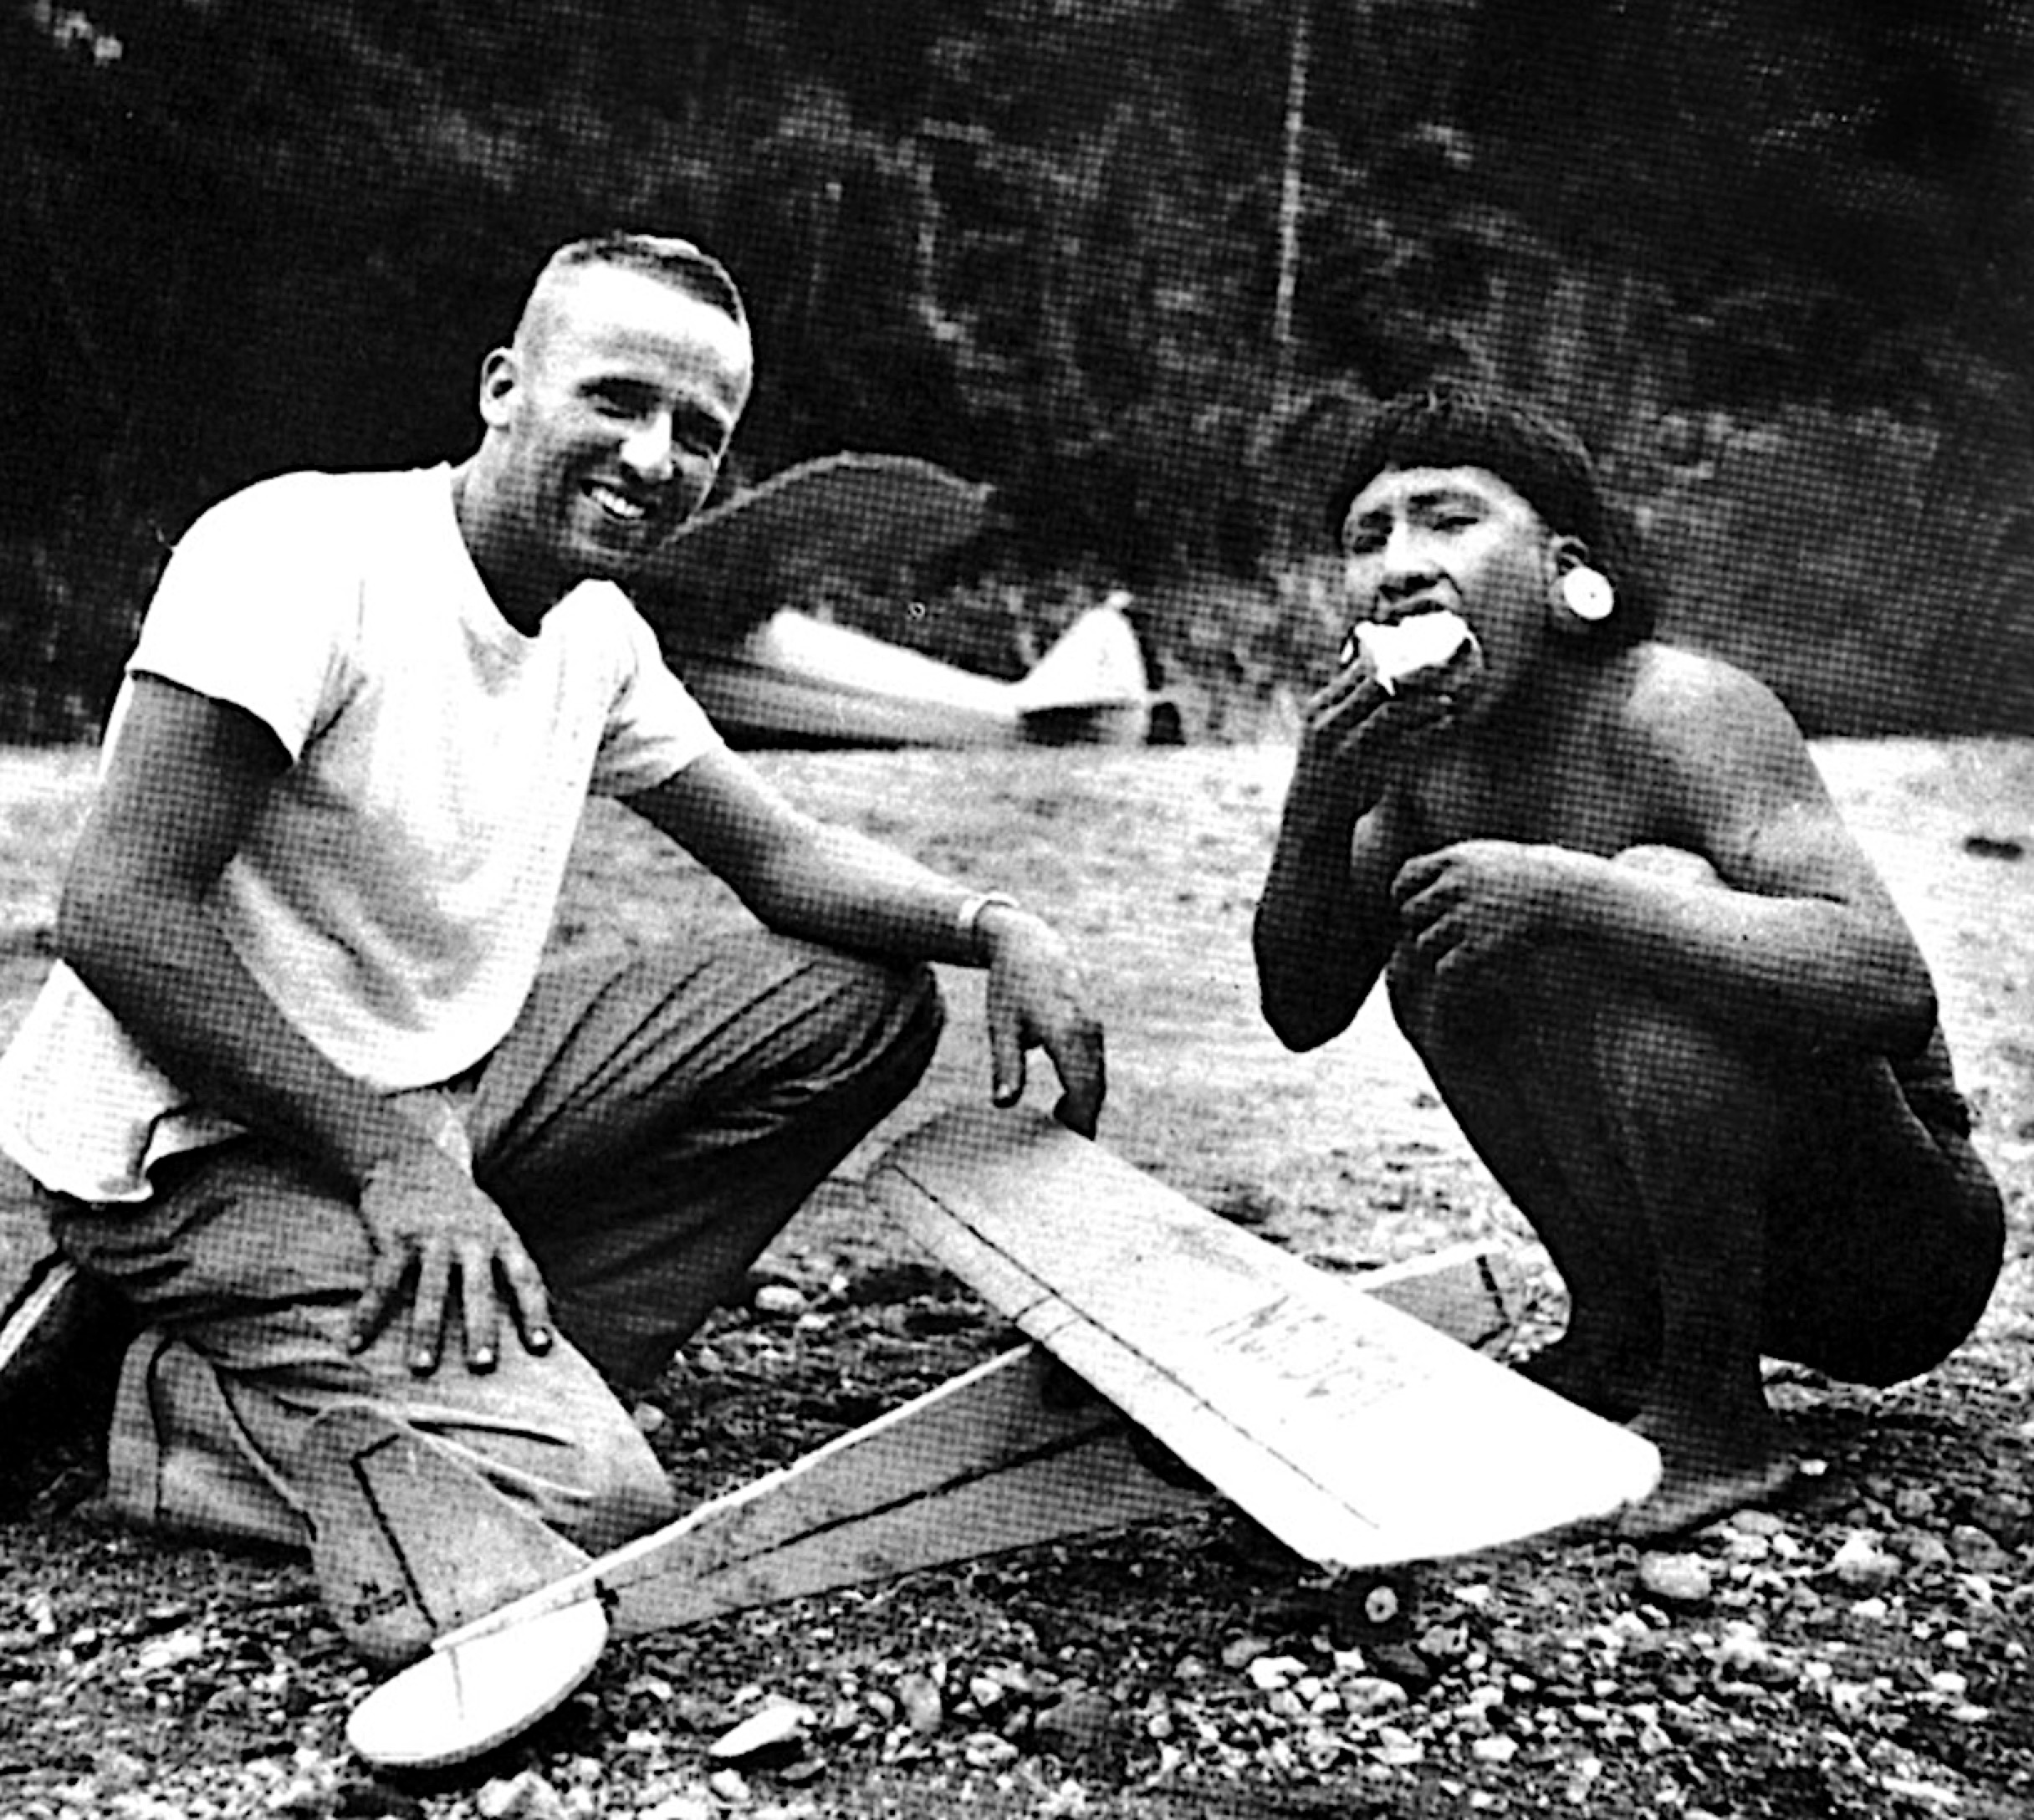
「为拯救不能失丧的灵魂，毫不保留献上，这种人绝不愚昧。」宣教士吉姆·艾略特
He is no fool who gives what he cannot keep to gain that which he cannot lose. (Jim Elliot)

Slide 27
我们为什么要感谢神？
Why must We be Thankful Towards God?
1：因为神是爱我们到底的神。
Because He Loves Us Deeply.
2：因为神是愿意拯救我们的神。Because He Delivers Us.
3：因为神是永远得胜的神。Because He is Eternally Victorious.

