Slide 1
Rev. Steven Fang 房正豪牧师

Slide 2
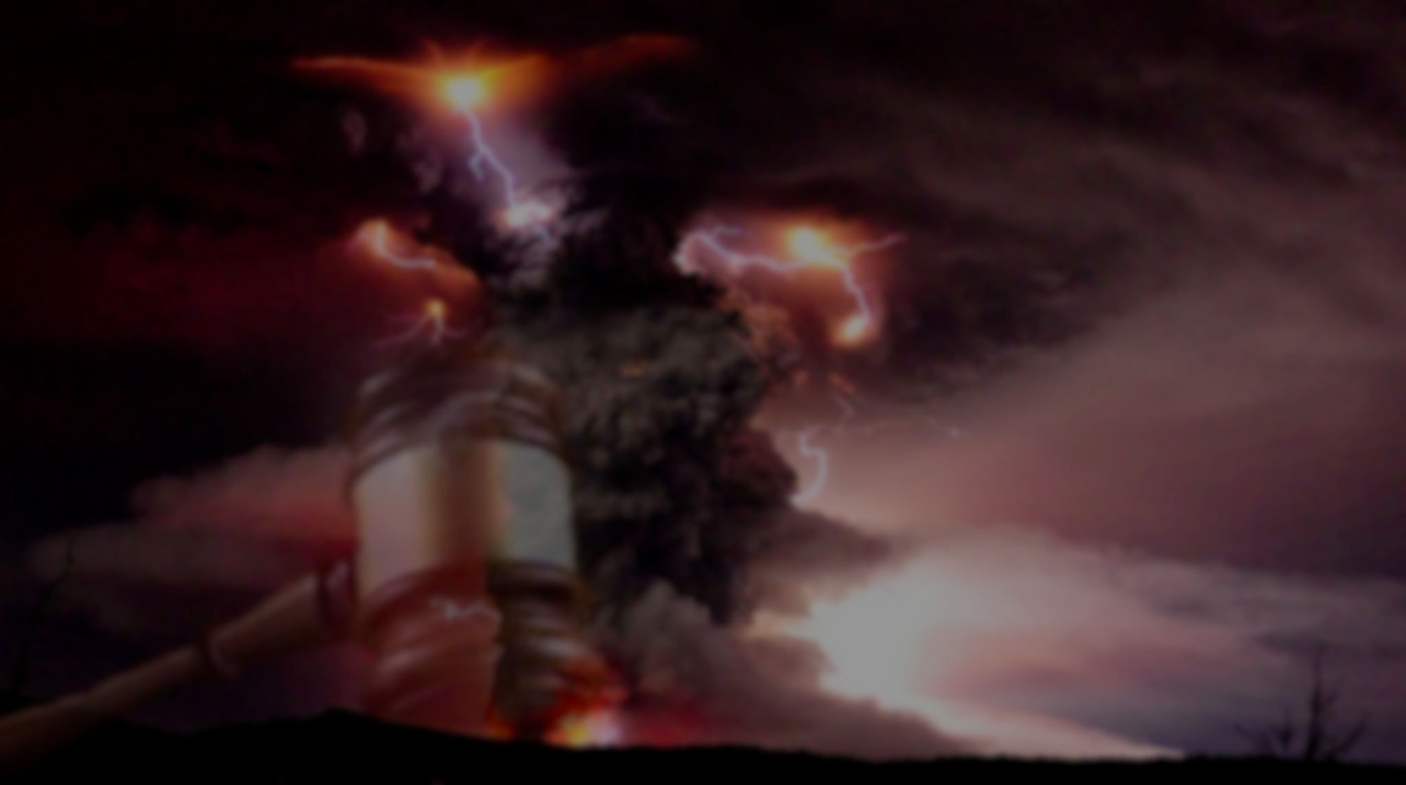
以西结书 Ezekiel 5:1-4
1 人子啊，你要拿一把快刀，当作剃头刀，用这刀剃你的头发和你的胡须，用天平将须发平分。
1 “Now, son of man, take a sharp sword and use it as a barber’s razor to shave your head and your beard. Then take a set of scales and divide up the hair.

Slide 3
2 围困城的日子满了，你要将三分之一在城中用火焚烧，将三分之一在城的四围用刀砍碎，将三分之一任风吹散。我也要拔刀追赶。
2 When the days of your siege come to an end, burn a third of the hair inside the city. Take a third and strike it with the sword all around the city. And scatter a third to the wind. For I will pursue them with drawn sword.

Slide 4
3 你要从其中取几根包在衣襟里，
3 But take a few hairs and tuck them away in the folds of your garment.
4 再从这几根中取些扔在火中焚烧，从里面必有火出来烧入以色列全家。。
4 Again, take a few of these and throw them into the fire and burn them up. A fire will spread from there to all Israel.

Slide 5
以西结书 Ezekiel 26:14-18
14 你们若不听从我，不遵行我的诫命， 14 “‘But if you will not listen to me and carry out all these commands,
15 厌弃我的律例，厌恶我的典章，不遵行我一切的诫命，背弃我的约，
15 and if you reject my decrees and abhor my laws and fail to carry out all my commands and so violate my covenant,

Slide 6
16 我待你们就要这样，我必命定惊惶，叫眼目干瘪，精神消耗的痨病热病辖制你们。你们也要白白地撒种，因为仇敌要吃你们所种的。
16 then I will do this to you: I will bring on you sudden terror, wasting diseases and fever that will destroy your sight and sap your strength. You will plant seed in vain, because your enemies will eat it.

Slide 7
17 我要向你们变脸，你们就要败在仇敌面前。恨恶你们的，必辖管你们，无人追赶，你们却要逃跑。
17 I will set my face against you so that you will be defeated by your enemies; those who hate you will rule over you, and you will flee even when no one is pursuing you.

Slide 8
18 你们因这些事若还不听从我，我就要为你们的罪加七倍惩罚你们。
18 “‘If after all this you will not listen to me, I will punish you for your sins seven times over.

Slide 9
以西结书 Ezekiel 12:29
因为我们的神乃是烈火。
for our “God is a consuming fire.”

Slide 10
以西结书 Ezekiel 5: 7
7 所以主耶和华如此说，因为你们纷争过于四围的列国，也不遵行我的律例，不谨守我的典章，并以遵从四围列国的恶规尚不满意，
7 “Therefore this is what the Sovereign Lord says: You have been more unruly than the nations around you and have not followed my decrees or kept my laws. You have not even conformed to the standards of the nations around you.

Slide 11
以西结书 Ezekiel 5: 8-10
8 所以主耶和华如此说，看哪，我与你反对，必在列国的眼前，在你中间，施行审判。
8 “Therefore this is what the Sovereign Lord says: I myself am against you, Jerusalem, and I will inflict punishment on you in the sight of the nations.

Slide 12
9 并且因你一切可憎的事，我要在你中间行我所未曾行的，以后我也不再照着行。
9 Because of all your detestable idols, I will do to you what I have never done before and will never do again.

Slide 13
10 在你中间父亲要吃儿子，儿子要吃父亲。我必向你施行审判，我必将你所剩下的分散四方。，
10 Therefore in your midst parents will eat their children, and children will eat their parents. I will inflict punishment on you and will scatter all your survivors to the winds.

Slide 14
申命记 Deuteronomy 28:53-55
53 你在仇敌围困窘迫之中，必吃你本身所生的，就是耶和华你神所赐给你的儿女之肉。
53 Because of the suffering your enemy will inflict on you during the siege, you will eat the fruit of the womb, the flesh of the sons and daughters the Lord your God has given you.

Slide 15
54 你们中间，柔弱娇嫩的人必恶眼看他弟兄和他怀中的妻，并他余剩的儿女。
54 Even the most gentle and sensitive man among you will have no compassion on his own brother or the wife he loves or his surviving children,

Slide 16
55 甚至在你受仇敌围困窘迫的城中，他要吃儿女的肉，不肯分一点给他的亲人，因为他一无所剩。
55 and he will not give to one of them any of the flesh of his children that he is eating. It will be all he has left because of the suffering your enemy will inflict on you during the siege of all your cities.

Slide 17
神是长期的忍耐、 劝勉、等待、警告人。 God is patient,
Exhortation, waiting, warning people.

Slide 18
以西结书 Ezekiel 5: 11
11 主耶和华说，我指着我的永生起誓，因你用一切可憎的物，可厌的事玷污了我的圣所，故此，我定要使你人数减少，我眼必不顾惜你，也不可怜你。
11 Therefore as surely as I live, declares the Sovereign Lord, because you have defiled my sanctuary with all your vile images and detestable practices, I myself will shave you; I will not look on you with pity or spare you.

Slide 19
以西结书 Ezekiel 5: 12
12 你的民三分之一必遭瘟疫而死，在你中间必因饥荒消灭。三分之一必在你四围倒在刀下。我必将三分之一分散四方，并要拔刀追赶他们。
12 A third of your people will die of the plague or perish by famine inside you; a third will fall by the sword outside your walls; and a third I will scatter to the winds and pursue with drawn sword.

Slide 20
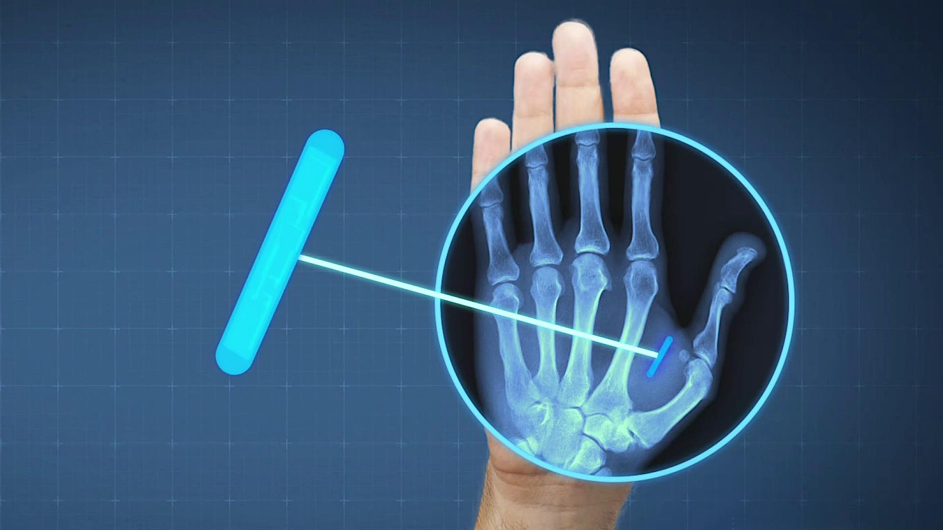
ID, wallet, keys all in your hand: Sweden moves into the future with microchipping
身份证、钱包、钥匙尽在掌握：瑞典通过微芯片走向未来

Slide 21
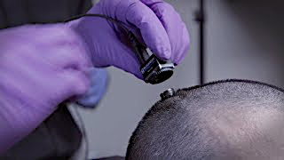
Watch brain implant help man 'speak' for the first time in 15 years.
15 年来第一次观看大脑植入物帮助人类“说话”。

Slide 22
Tech company will implant payment chip into your hand
科技公司将支付芯片植入你的手中

Slide 23
七大危机 Seven crises
1.世界政府 world government 2.财经混乱 Financial chaos 3.情欲混乱 Erotic confusion 4.多人离弃信仰 Many have turned away from the faith 5..社会主义流行 Socialism in vogue 6.怪病大流行 Strange disease pandemic 7.取消文化倡行 Cancel culture advocacy

Slide 24
基督徒当做三件事
Christians do three things
1.坚持基督的信仰
Hold fast to the faith of Christ 2. 连接更多肢体
Connect with more Christians 3.全心传扬好消息
Spreading good news with whole heart !

Slide 25
以赛亚书 Isaiah 52:7
7 那报佳音，传平安，报好信，传救恩的，对锡安说，你的神作王了。这人的脚登山何等佳美
7 How beautiful on the mountains
are the feet of those who bring good news, who proclaim peace,
who bring good tidings,
who proclaim salvation,
who say to Zion, “Your God reigns!”

Slide 26
罗马书 Romans 10:15
15 若没有奉差遣，怎能传道呢？如经上所记，报福音传喜信的人，他们的脚踪何等佳美，15 And how can anyone preach unless they are sent? As it is written: “How beautiful are the feet of those who bring good news!”

Slide 27
雅各书 James 4:13-14
13 嗐、 你们有话说，今天明天我们要往某城里去，在那里住一年，作买卖得利。
13 Now listen, you who say, “Today or tomorrow we will go to this or that city, spend a year there, carry on business and make money.”

Slide 28
14 其实明天如何，你们还不知道。你们的生命是什么呢？你们原来是一片云雾，出现少时就不见了。，
14 Why, you do not even know what will happen tomorrow. What is your life? You are a mist that appears for a little while and then vanishes.

Slide 29
雅各书 James 4:15
15 你们只当说，主若愿意，我们就可以活着，也可以作这事，或作那事。
15 Instead, you ought to say, “If it is the Lord’s will, we will live and do this or that.”

