Slide 1
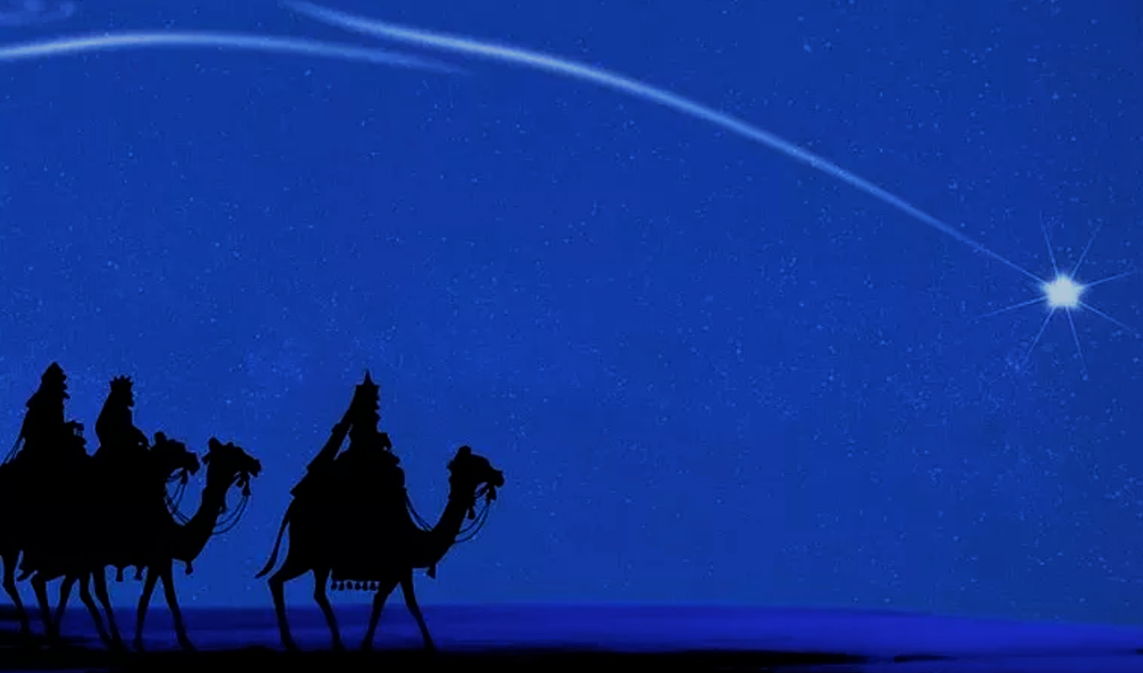
平 安 從 哪 來？
Where does
“ Peace ”
come from?

Slide 2
约翰福音 John 14:27
我留下平安给你们，我将我的平安赐给你们。我所赐的不像世人所赐的，你们心里不要忧愁，也不要胆怯。
Peace I leave with you; my peace I give you. I do not give to you as the world gives. Do not let your hearts be troubled and do not be afraid.

Slide 3
约翰福音 John 16:33
我将这些事告诉你们，是要叫你们在我里面有平安。在世上你们有苦难，但你们可以放心，我已经胜了世界。
“I have told you these things, so that in me you may have peace. In this world you will have trouble. But take heart! I have overcome the world.”

Slide 4
三个重点
1. 你必须是属于耶稣基督的人吗！
就是和他有关系的人吗！
2. 主应许我们，祂与我们同在！
他就是我们的磐石，我们的力量！
3. 环境可能困难，问题还没解决，
但是我们有神所赐的内心平安！

Slide 5
Three important points
1. You must belong to Jesus, you have established relationship with Him.
2. Jesus promised us that He is with us, He is our Rock, our strength
3. Even through we still have problems, but we have peach.

Slide 6
路加福音 2:10-11
10 那天使对他们说：“不要惧怕，我报给你们大喜的信息，是关乎万民的。
11 因今天在大卫的城里，为你们生了救主，就是主基督。

Slide 7
Luke 2:10-11
10 But the angel said to them, “Do not be afraid. I bring you good news that will cause great joy for all the people.
11 Today in the town of David a Savior has been born to you; he is the Messiah, the Lord.

Slide 8
路加福音 2:13-14
13 忽然有一大队天兵，同那天使赞美神说：
14 “在至高之处荣耀归于神！在地上平安归于他所喜悦的人！”

Slide 9
Luke 2:13-14
13 Suddenly a great company of the heavenly host appeared with the angel, praising God and saying,
14 “Glory to God in the highest heaven,
and on earth peace to those on whom his favor rests.”

Slide 10
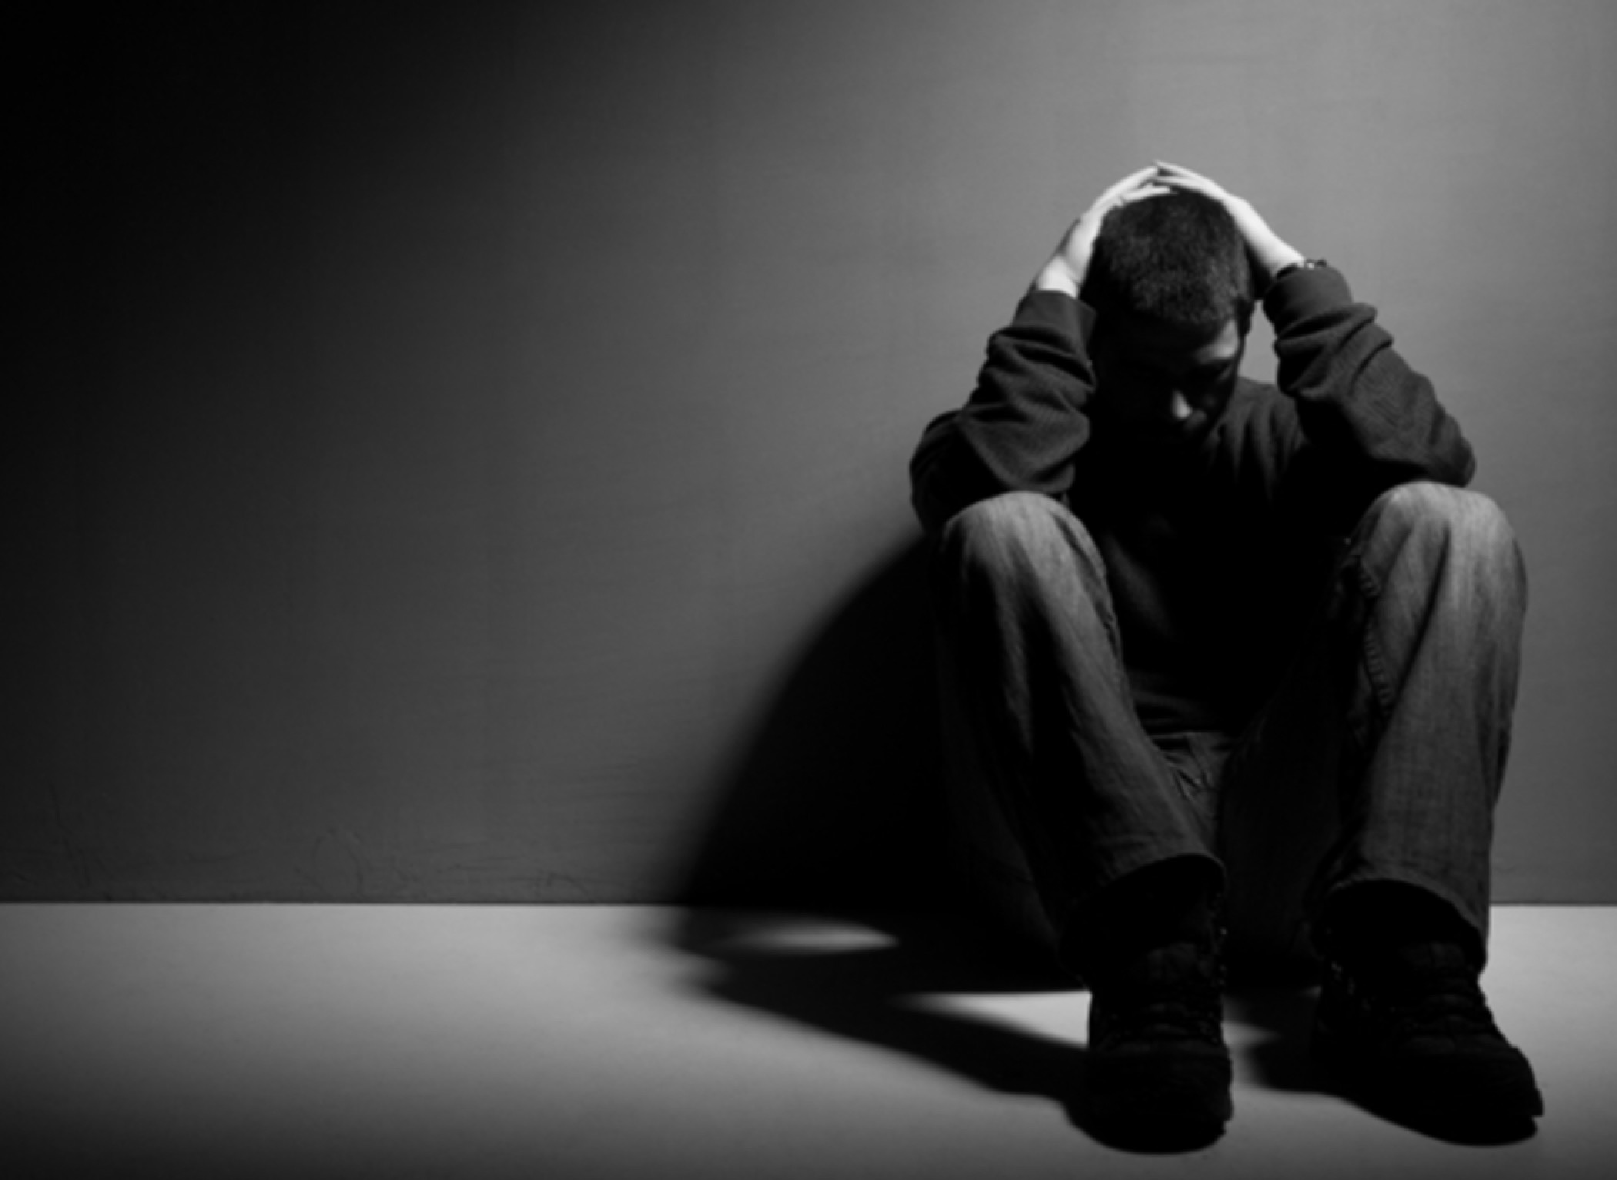
撒但攻擊
工作壓力
健康亮紅燈
夫妻吵架
孩子不聽話

Slide 11
Satan attacking
Stress from work
Health problem
Children disobey
Fighting among marriage

Slide 12
《圣经》的四大部分
1. 神的创造
( 神按神的形象造了人)
2. 人的堕落
(人却自己选择不听神的话)
3. 罪控制了人
(所有的人都成了罪的奴仆)
4. 耶稣的救赎
(基督来到地上为要拯救罪人)

Slide 13
Four parts of Bible
1. God's creation
" God created man in the image of God "
2. The fall of man
" man choose not to listen to God "
3. Sin controls man
" All men become slaves to sin "
4. Redemption of Jesus
" Christ came to earth to save sinners "

Slide 14
主來有三方面的恩典
1. 他来，要釋放在罪中的人。
2. 他来，要将真平安给我们。
3. 他来，要给我们新生命。
Jesus grace
1. He came to release those who are in Sin
2. He came to give us real peace
3. He came to give us new lives.

Slide 15
加拉太书 4:4-6
4 及至时候满足，神就差遣他的儿子，为女子所生，且生在律法以下，
5 要把律法以下的人赎出来，叫我们得着儿子的名分。
6 你们既为儿子，神就差他儿子的灵进入你们[a]的心，呼叫：“阿爸！父！”

Slide 16
Galatians 4:4-6
4 But when the set time had fully come, God sent his Son, born of a woman, born under the law,
5 to redeem those under the law, that we might receive adoption to sonship.
6 Because you are his sons, God sent the Spirit of his Son into our hearts, the Spirit who calls out, “Abba, Father.”

Slide 17
大家一起
“竭誠為主”
主必纪念你所做的一切
We'll do our best for our Lord !
The Lord will remember what
you've done for Him !

