Slide 1
4/21/ 2019

Slide 2
主復活對我們的意義
The Meaning of the Lord’s
Resurrection to us.

Slide 3
哥林多前書 15:35-37
35 或有人問：「死人怎樣復活，帶著什麼身體來呢？」 36 無知的人哪！你所種的，若不死就不能生。 37 並且你所種的不是那將來的形體，不過是子粒，即如麥子，或是別樣的穀；

Slide 4
1 Corinthians 15:35-37
35 But someone will ask, “How are the dead raised? With what kind of body will they come?” 36 How foolish! What you sow does not come to life unless it dies. 37 When you sow, you do not plant the body that will be, but just a seed, perhaps of wheat or of something else.

Slide 5
哥林多前書 1 Corinthians 15:37
37 並且你所種的不是那將來的形體，不過是子粒，即如麥子，或是別樣的穀；
When you sow, you do not plant the body that will be, but just a seed, perhaps of wheat or of something else.

Slide 6
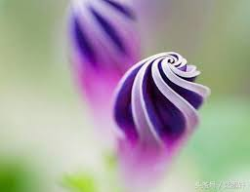
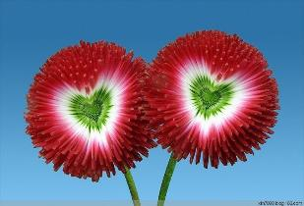
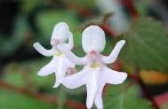
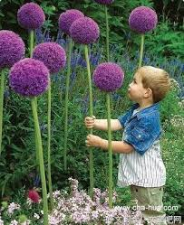
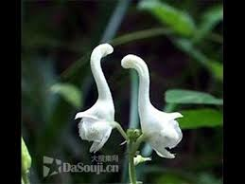
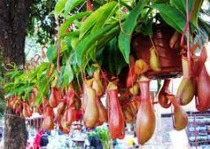

Slide 7
哥林多前書 15:38-41
38 但神隨自己的意思給它一個形體，並叫各等子粒各有自己的形體。
39 凡肉體各有不同：人是一樣，獸又是一樣，鳥又是一樣，魚又是一樣。

Slide 8
哥林多前書 15:38-41
40 有天上的形體，也有地上的形體；但天上形體的榮光是一樣，地上形體的榮光又是一樣。
41 日有日的榮光，月有月的榮光，星有星的榮光，這星和那星的榮光也有分別。

Slide 9
1 Corinthians 15:38-41
38 But God gives it a body as he has determined, and to each kind of seed he gives its own body.
39 Not all flesh is the same: People have one kind of flesh, animals have another, birds another and fish another.

Slide 10
1 Corinthians 15:38-41
40 There are also heavenly bodies and there are earthly bodies; but the splendor of the heavenly bodies is one kind, and the splendor of the earthly bodies is another.
41 The sun has one kind of splendor, the moon another and the stars another; and star differs from star in splendor.

Slide 11
哥林多前書 15:42-44
42 死人復活也是這樣：所種的是必朽壞的，復活的是不朽壞的；
43 所種的是羞辱的，復活的是榮耀的；所種的是軟弱的，復活的是強壯的；

Slide 12
哥林多前書 15:42-44
44 所種的是血氣的身體，復活的是靈性的身體。若有血氣的身體，也必有靈性的身體。

Slide 13
1 Corinthians 15:42-44
42 So will it be with the resurrection of the dead. The body that is sown is perishable, it is raised imperishable;
43 it is sown in dishonor, it is raised in glory; it is sown in weakness, it is raised in power;
44 it is sown a natural body, it is raised a spiritual body.

Slide 14
（一）朽壞的要變成不朽壞的
The perishable
become imperishable

Slide 15
（二）從羞辱的變成榮耀
From shame to glory

Slide 16
腓立比書 Philippians 3:21
21 他要按著那能叫萬有歸服自己的大能，將我們這卑賤的身體改變形狀，和他自己榮耀的身體相似。who, by the power that enables him to bring everything under his control, will transform our lowly bodies so that they will be like his glorious body.

Slide 17
（三）從軟弱變成剛強的
from weakness to strength

Slide 18
哥林多前書 1 Corinthians 15:44
44 所種的是血氣的身體，復活的是靈性的身體。若有血氣的身體，也必有靈性的身體。
it is sown a natural body,
it is raised a spiritual body.

Slide 19
（四）從血氣得變成靈性
From natural to spiritual

Slide 20
（五）從必死的變成不死的
From mortal to immortal

Slide 21
哥林多前書 1 Corinthians 15:54
54 這必朽壞的既變成不朽壞的，這必死的既變成不死的，那時經上所記「死被得勝吞滅」的話就應驗了。
When the perishable has been clothed with the imperishable, and the mortal with immortality, then the saying that is written will come true: “Death has been swallowed up in victory.”

Slide 22
主復活對我們的意義
The Meaning of the Lord’s Resurrection to us.
（一）朽壞的要變成不朽壞的
The perishable become imperishable
（二）從羞辱的變成榮耀
From shame to glory
（三）從軟弱變成剛強的
From weakness to strength
（四）從血氣得變成靈性
From natural to spiritual
（五）從必死的變成不死的
From mortal to immortal

