Slide 1
房正豪牧师
Rev. Steven Fang

Slide 2
腓利比书 Philippians 1:1-6
1基督耶稣的仆人保罗，和提摩太，写信给凡住腓立比，在基督耶稣里的众圣徒，和诸位监督，诸位执事。
1 Paul and Timothy, servants of Christ Jesus,
To all God’s holy people in Christ Jesus at Philippi, together with the overseers and deacons:
2 愿恩惠平安，从神我们的父，并主耶稣基督，归与你们。
2 Grace and peace to you from God our Father and the Lord Jesus Christ.
3 我每逢想念你们，就感谢我的神。
3 I thank my God every time I remember you.

Slide 3
4 （每逢为你们众人祈求的时候，常是欢欢喜喜地祈求）
4 In all my prayers for all of you, I always pray with joy
5 因为从头一天直到如今，你们是同心合意地兴旺福音。
5 because of your partnership in the gospel from the first day until now,
6 我深信那在你们心里动了善工的，必成全这工，直到耶稣基督的日子。
6 being confident of this, that he who began a good work in you will carry it on to completion until the day of Christ Jesus.

Slide 4
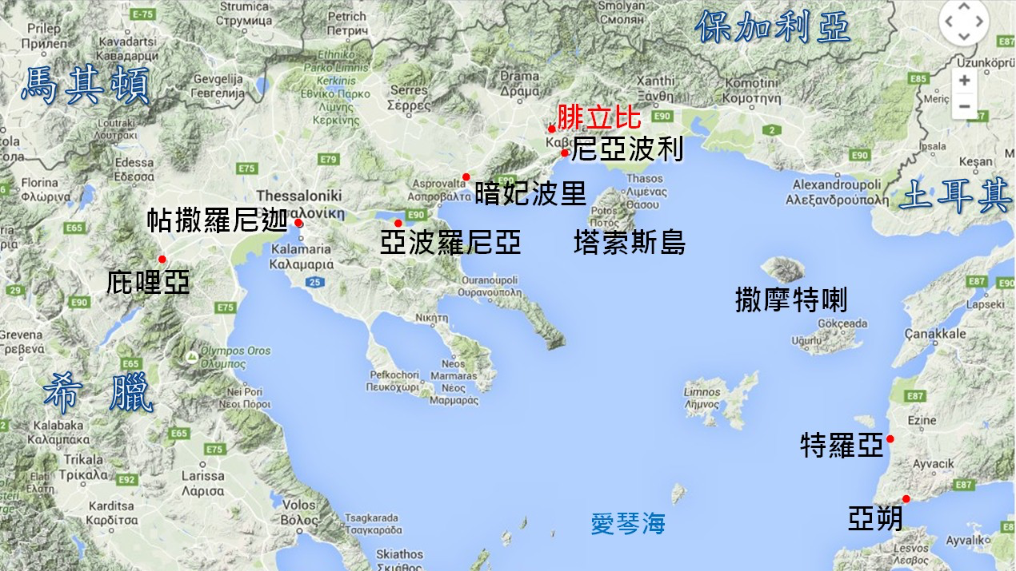
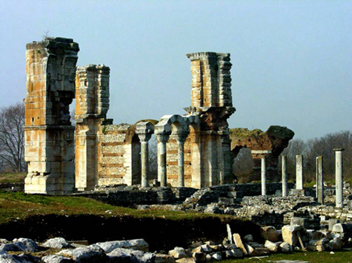

Slide 5
腓利比书 Philippians 1:3-4
3 我每逢想念你们，就感谢我的神。
3 I thank my God every time I remember you.
4 （每逢为你们众人祈求的时候，常是欢欢喜喜地祈求）
4 In all my prayers for all of you, I always pray with joy

Slide 6
腓利比书 Philippians 1:5
5 因为从头一天直到如今，你们是同心合意地兴旺福音。
5 because of your partnership in the gospel from the first day until now,

Slide 7
雅各书 James 1:22
只是你们要行道，不要单单听道，
自己欺哄自己。
Do not merely listen to the word, and so deceive yourselves.
Do what it says.

Slide 8
福音的三有
Gospel has three
1. 有神 There is a God
2. 有罪 Human Sins
3. 有救 There is Salvation

Slide 9
神六大属性 Gospel has three
1. 慈爱 Kindness

Slide 10
神六大属性 Gospel has three
1. 慈爱 Kindness
2. 公义 Justice

Slide 11
神六大属性 Gospel has three
1. 慈爱 Kindness
2. 公义 Justice
3. 圣洁 Holy

Slide 12
神六大属性 Gospel has three
1. 慈爱 Kindness
2. 公义 Justice
3. 圣洁 Holy
4. 信实 Faithfulness

Slide 13
神六大属性 Gospel has three
1. 慈爱 Kindness
2. 公义 Justice
3. 圣洁 Holy
4. 信实 Faithfulness
5. 权能 Authority

Slide 14
神六大属性 Gospel has three
1. 慈爱 Kindness
2. 公义 Justice
3. 圣洁 Holy
4. 信实 Faithfulness
5. 权能 Authority
6. 救赎 Redemption

Slide 15
罗马书 Philippians 3:23-24
23 因为世人都犯了罪，亏缺了神的荣耀。
23 for all have sinned and fall short of the glory of God,
24 如今却蒙神的恩典，因基督耶稣的救赎，就白白地称义。
24 and all are justified freely by his grace through the redemption that came by Christ Jesus.

Slide 16
腓利比书 Philippians 1:5-6
5 因为从头一天直到如今，你们是同心合意地兴旺福音。
5 because of your partnership in the gospel from the first day until now,
6 我深信那在你们心里动了善工的，必成全这工，直到耶稣基督的日子。
6 being confident of this, that he who began a good work in you will carry it on to completion until the day of Christ Jesus.

Slide 17
马可福音 Mark 1:15-18
14 约翰下监以后，耶稣来到加利利，宣传神的福音
14 After John was put in prison, Jesus went into Galilee, proclaiming the good news of God. ，
15 说，日期满了，神的国近了。你们当悔改，信福音。
15 “The time has come,” he said. “The kingdom of God has come near. Repent and believe the good news!”
16 耶稣顺着加利利的海边走，看见西门，和西门的兄弟安得烈，在海里撒网。他们本是打鱼的。
16 As Jesus walked beside the Sea of Galilee, he saw Simon and his brother Andrew casting a net into the lake, for they were fishermen.

Slide 18
17 耶稣对他们说，来跟从我，我要叫你们得人如得鱼一样。
17 “Come, follow me,” Jesus said, “and I will send you out to fish for people
18 他们就立刻舍了网，跟从了他。
18 At once they left their nets and followed him.

Slide 19
李玟 CoCo Lee

Slide 20
腓利比书 Philippians 3:20-21
20 我们却是天上的国民。并且等候救主，就是主耶稣基督，从天上降临。
20 But our citizenship is in heaven. And we eagerly await a Savior from there, the Lord Jesus Christ,
21 他要按着那能叫万有归服自己的大能，将我们这卑贱的身体改变形状，和他自己荣耀的身体相似。
21 who, by the power that enables him to bring everything under his control, will transform our lowly bodies so that they will be like his glorious body.

Slide 21
天下无不散的筵席
天上却有永远的筵席
There is no feast without dissolution in the world
but there is an eternal feast in heaven

Slide 22
撒但三只毒箭
Satan's Three Poisoned Arrows

Slide 23
人得救必须来到耶稣基督十架前！
To be saved, one must
come to the cross of Jesus Christ!

Slide 24
撒但三只毒箭
Satan's Three Poisoned Arrows
1. 使人忧虑 To worry
2. 使人害怕 To scare
3. 使人怀疑（神）
To make people doubt (God)

Slide 25
彼得前书 1 Peter 5:7-9
7 你们要将一切的忧虑卸给神，因为他顾念你们。
7 Cast all your anxiety on him because he cares for you.
8 务要谨守，儆醒。因为你们的仇敌魔鬼，如同吼叫的狮子，遍地游行，寻找可吞吃的人。
8 Be alert and of sober mind. Your enemy the devil prowls around like a roaring lion looking for someone to devour.

Slide 26
9 你们要用坚固的信心抵挡他，因为知道你们在世上的众弟兄，也是经历这样的苦难。 9 Resist him, standing firm in the faith, because you know that the family of believers throughout the world is undergoing the same kind of sufferings.

Slide 27
主的恩典
Lord's grace
靠主喜 乐rejoice in the Lord
刚强壮胆 strong and courageous
圣灵内住 Holy Spirit indwells

Slide 28
罗马书 Romans 1:17
因为神的义，正在这福音上显明出来。这义是本于信以致于信。
如经上所记，义人必因信得生。
For in the gospel the righteousness of God is revealed—a righteousness that is by faith from first to last, just as it is written: “The righteous will live by faith.”

