Slide 1
English Translation starts NOW
Outside of church
Dial 425-650-1398
Use Conference Code 849387
In House
WI-FI Network = Listen Everywhere
Password: 12345678
Open Listen Everywhere App

Slide 2

邱清忠弟兄
Bro. Jack Chiu

Slide 3


Slide 4
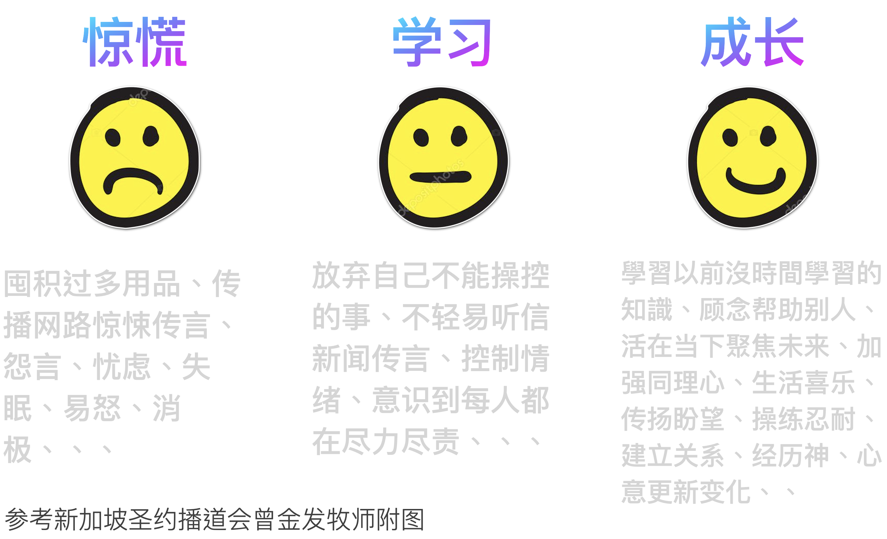

Slide 5
Panic
Stock up on excess supplies; Spread scary rumors on the internet; Complaining, worry, insomnia, irritability, negativity...
Study
Give up what you can't control; Do not easily listen to news or rumors; Control emotions; Realizing that everyone is doing their best...
Growth
Learn what you haven't had time to learn before; Be mindful of helping others; Live in the present and focus on the future; Strengthen empathy; Live joyfully; Spread hope; Practice patience; Build relationships; Experience God; Be transformed by the renewal of mind...

Slide 6
神的话语 & 经历神
God’s Word & Experience God

Slide 7


Slide 8


Slide 9
罗马书 Romans 12:12
12 在 指 望 中 要 喜 乐 ， 在 患 难 中 要 忍 耐 ， 祷 告 要 恒 切 。
12 Be joyful in hope, patient in trouble, and persistent in prayer.

Slide 10
希 伯 來 書 Hebrews 11:1
信就是所望之事的实底，
是未见之事的确据。
Now faith is the assurance that what we hope for will come about and the certainty that what we cannot see exists.

Slide 11


没指望
Hopeless
有指望
Hopeful

Slide 12
箴 言 Proverbs 17:22
喜 乐 的 心 乃 是 良 药 ；
忧 伤 的 灵 使 骨 枯 乾 。
A joyful heart is good medicine,
but a broken spirit drains one’s strength.

Slide 13
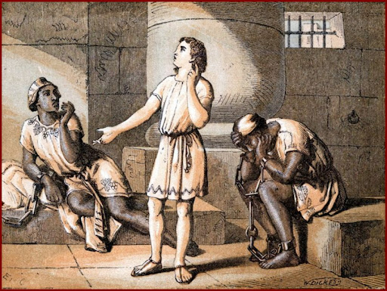
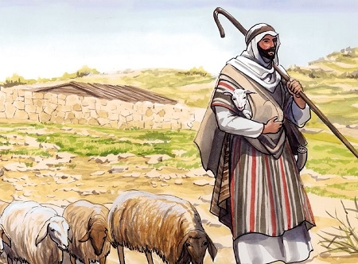
约瑟
Joseph
摩西
Moses

Slide 14
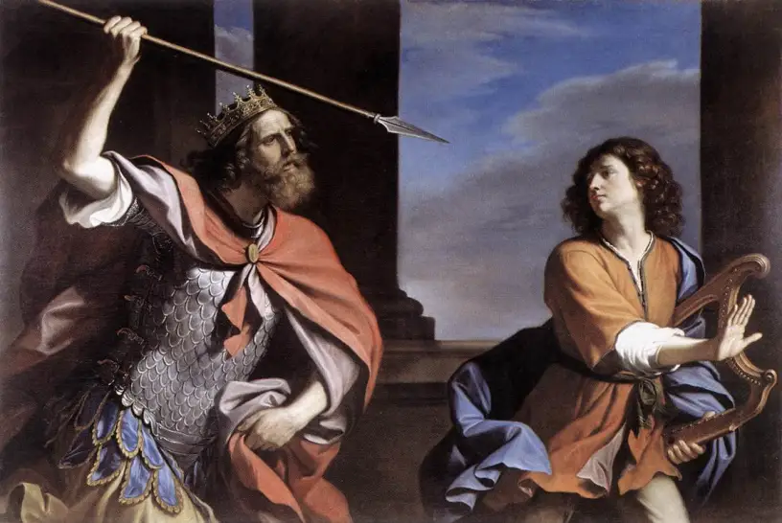

大卫
David
耶稣基督
Jesus Christ

Slide 15
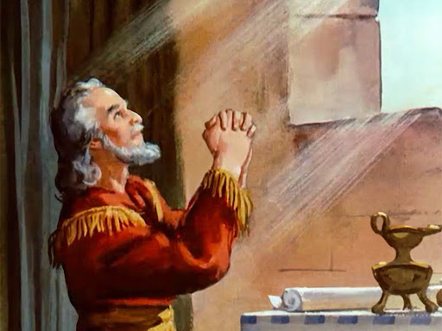
祷告学
但以理
Learn from Daniel in prayer.

Slide 16
指 望 中 要 喜 乐
患 难 中 要 忍 耐
祷 告 要 恒 切
Be joyful in hope,
patient in trouble,
and persistent in prayer.

Slide 17
以 賽 亞 書 Isaiah 12:3
所以，你们必从救恩的泉源
欢然取水。
You will draw water joyfully from the wells of salvation. And you will say at that time:

