Slide 1
Discussion Time 讨论时间
What is the purpose of money?
钱的用途是什么？

Slide 2
Money in Times of Uncertainty 在不稳定的时期 如何使用钱财
I Timothy 提摩太前书 6: 6-12; 17-19

Slide 3
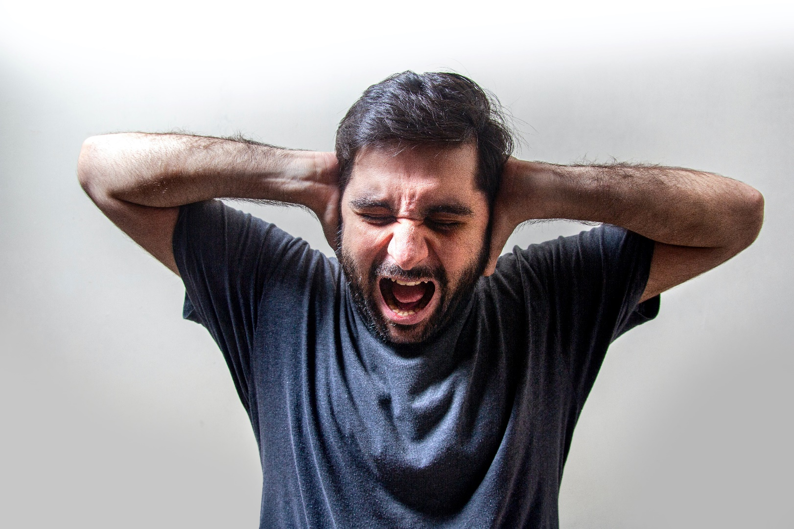
Drought & lockdowns in China
8.5% inflation
2+ years of Covid-19 disease
Flooding in Pakistan
2+ years of government response
War in Ukraine

Slide 4
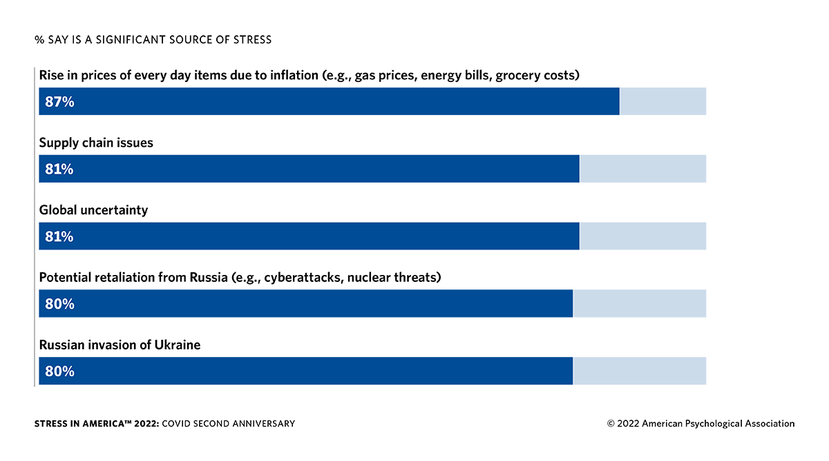
Stressed States of America 受压力的美利坚合众国

Slide 5
Effects of Financial Stress 金融压力的影响
Family
家庭
Mental Health心理健康
Physical Health
生理健康
Spiritual Health
灵性健康

Slide 6
How do we get through this? 我们如何度过难关？

Slide 7
I Timothy 提摩太前书 6:6-12; 17-19
But godliness with contentment is great gain, for we brought nothing into the world, and we cannot take anything out of the world. But if we have food and clothing, with these we will be content. But those who desire to be rich fall into temptation, into a snare, into many senseless and harmful desires that plunge people into ruin and destruction.
然而敬虔加上知足的心便是大利了。因为我们没有带什么到世上来，也不能带什么去。只要有衣有食，就当知足。但那些想要发财的人，就陷在迷惑，落在网罗，和许多无知有害的私欲里，叫人沉在败坏和灭亡中。

Slide 8
For the love of money is a root of all kinds of evils. It is through this craving that some have wandered away from the faith and pierced themselves with many pangs. But as for you, O man of God, flee these things. Pursue righteousness, godliness, faith, love, steadfastness, gentleness. Fight the good fight of the faith. Take hold of the eternal life to which you were called and about which you made the good confession in the presence of many witnesses.
贪财是万恶之根。有人贪恋钱财，就被引诱离了真道，用许多愁苦把自己刺透了。但你这属神的人，要逃避这些事，追求公义，敬虔，信心，爱心，忍耐，温柔。你要为真道打那美好的仗，持定永生。你为此被召，也在许多见证人面前，已经作了那美好的见证。

Slide 9
As for the rich in this present age, charge them not to be haughty, nor to set their hopes on the uncertainty of riches, but on God, who richly provides us with everything to enjoy. They are to do good, to be rich in good works, to be generous and ready to share, thus storing up treasure for themselves as a good foundation for the future, so that they may take hold of that which is truly life.
你要嘱咐那些今世富足的人，不要自高，也不要倚靠无定的钱财。只要倚靠那厚赐百物给我们享受的神。又要嘱咐他们行善，在好事上富足，甘心施舍，乐意供给人，为自己积成美好的根基，预备将来，叫他们持定那真正的生命。

Slide 10
How should we relate to money?
我们应该如何与金钱相处？

Slide 11
Contentment 知足

Slide 12
What is Contentment? 知足是什么？
“Having one's desires bounded by what one has (though that may be less than one could have wished).”
“一个人的欲望受到一个人所拥有的东西的限制（尽管这可能比一个人所希望的要少）。”
Contentment 知足 =

Slide 13
Humility 谦虚

Slide 14
How to be Humble: 如何谦虚：
Do not allow money to determine our value or others’ value
不要让金钱来决定我们的价值或他人的价值

Slide 15
Mastery 精通

Slide 16
“You possess your possessions, or they possess you.” “
你占有你的财产，或者他们占有你。”
Jon Foreman
喬恩·福爾曼

Slide 17
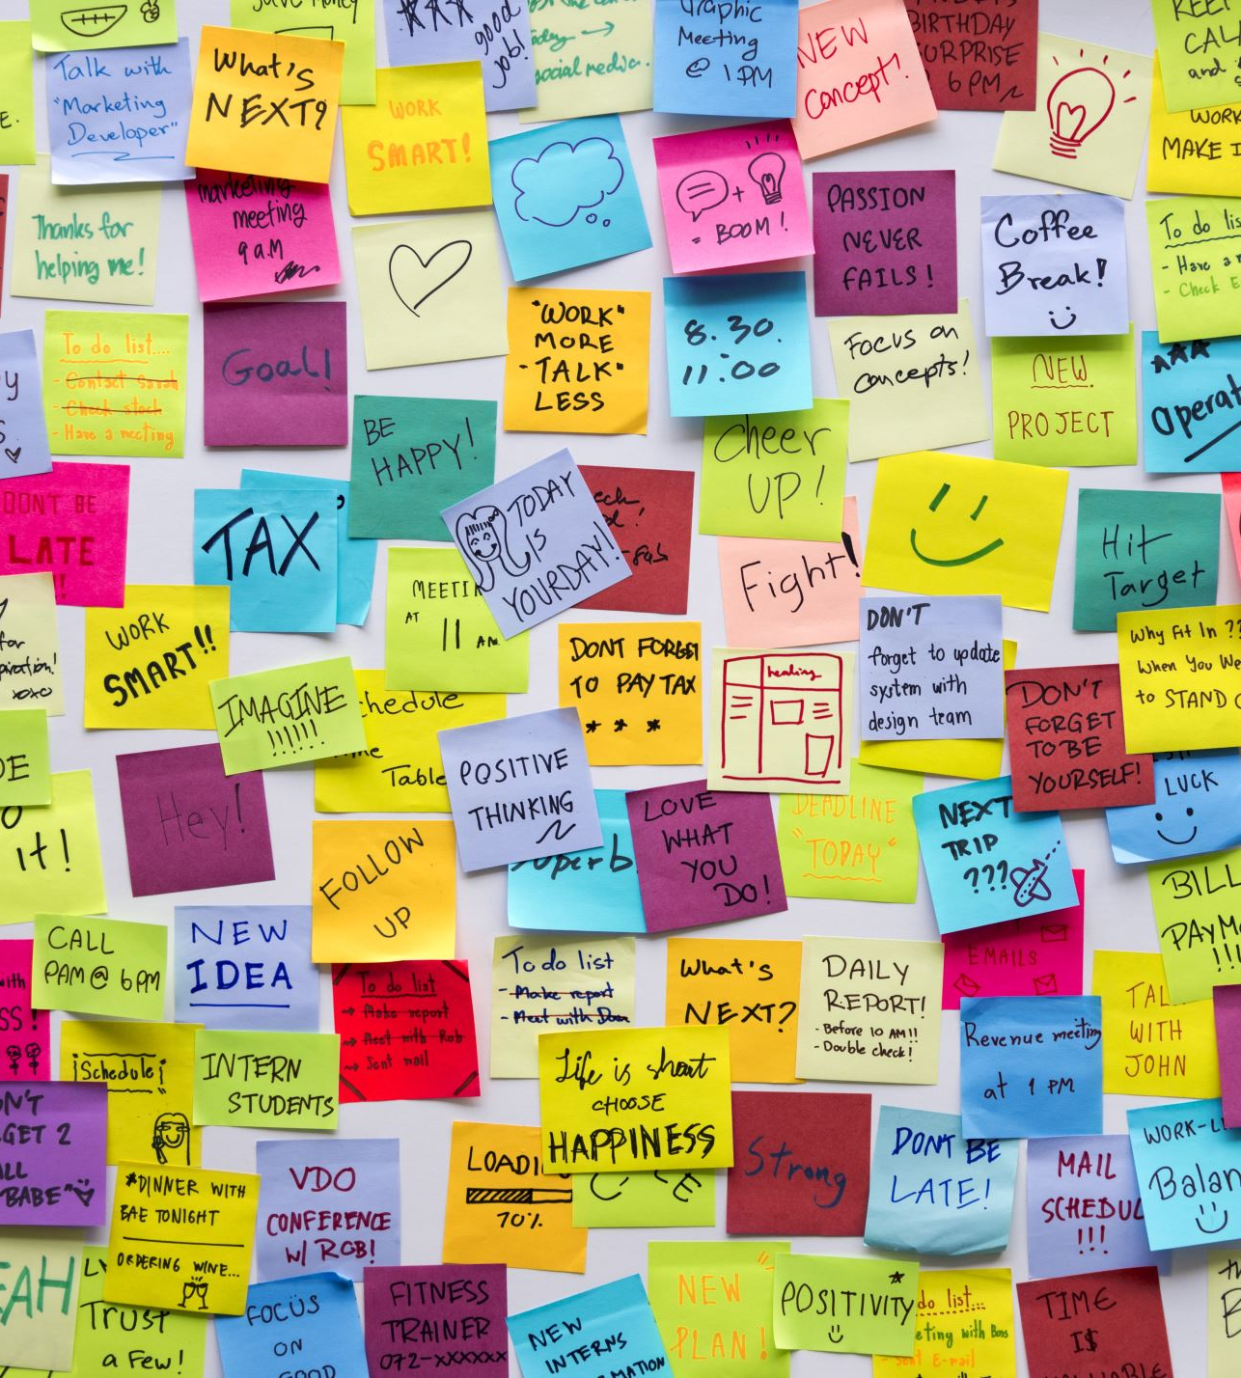
What are my priorities? 我的优先事项是什么？

Slide 18
Money is a tool for: 金钱是一种工具：
Providing for family and friends 提供给家人和朋友
Meeting people’s needs 满足人们的需求
Paying taxes 缴纳税款
Preparing for the future 为未来做好准备
The Church 教会
Missions 使命

Slide 19
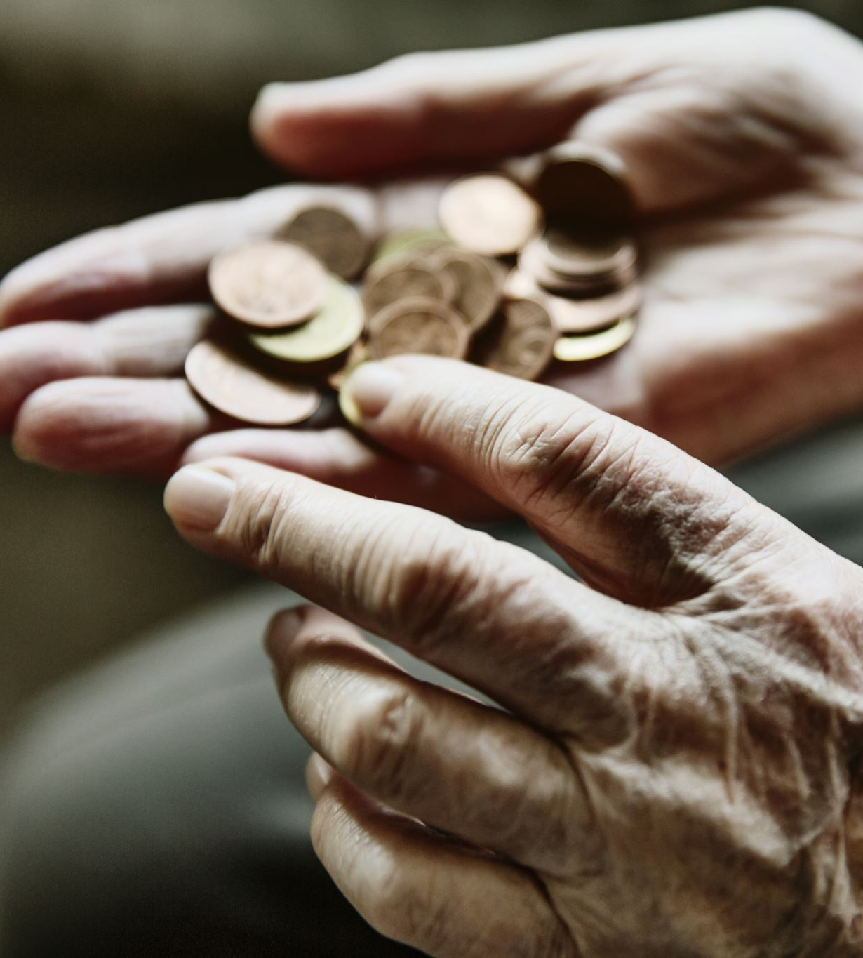
Let’s Remember: 让我们记住：
Be content with what we have
满足于我们拥有的东西
Be humble regardless of our wealth
不管我们的财富如何，都要谦虚
Order our priorities so that money is not our master
安排我们的优先事项，
这样金钱就不是我们的主人

